Slide 1

Integrated Parameter Study and Serviceability Assessment of Building Structures under Geothermally Induced Seismicity using Stochastic Polynomial Chaos Expansion
B.Sc. Wei-Teng, Kao
Technical University of Munich
TUM School of Engineering and Design
Chair of Structural Mechanics
Munich, 22.08.2024

Slide 2
Introduction and Motivation

Slide 3
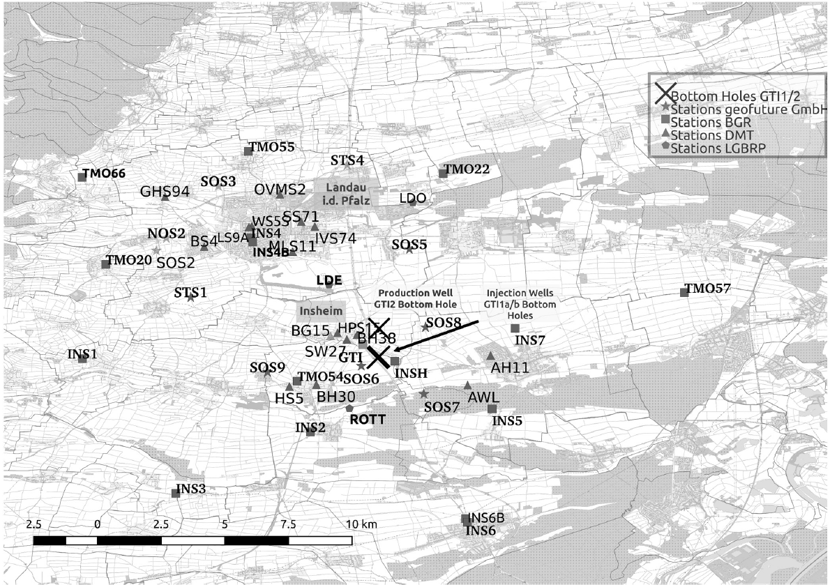
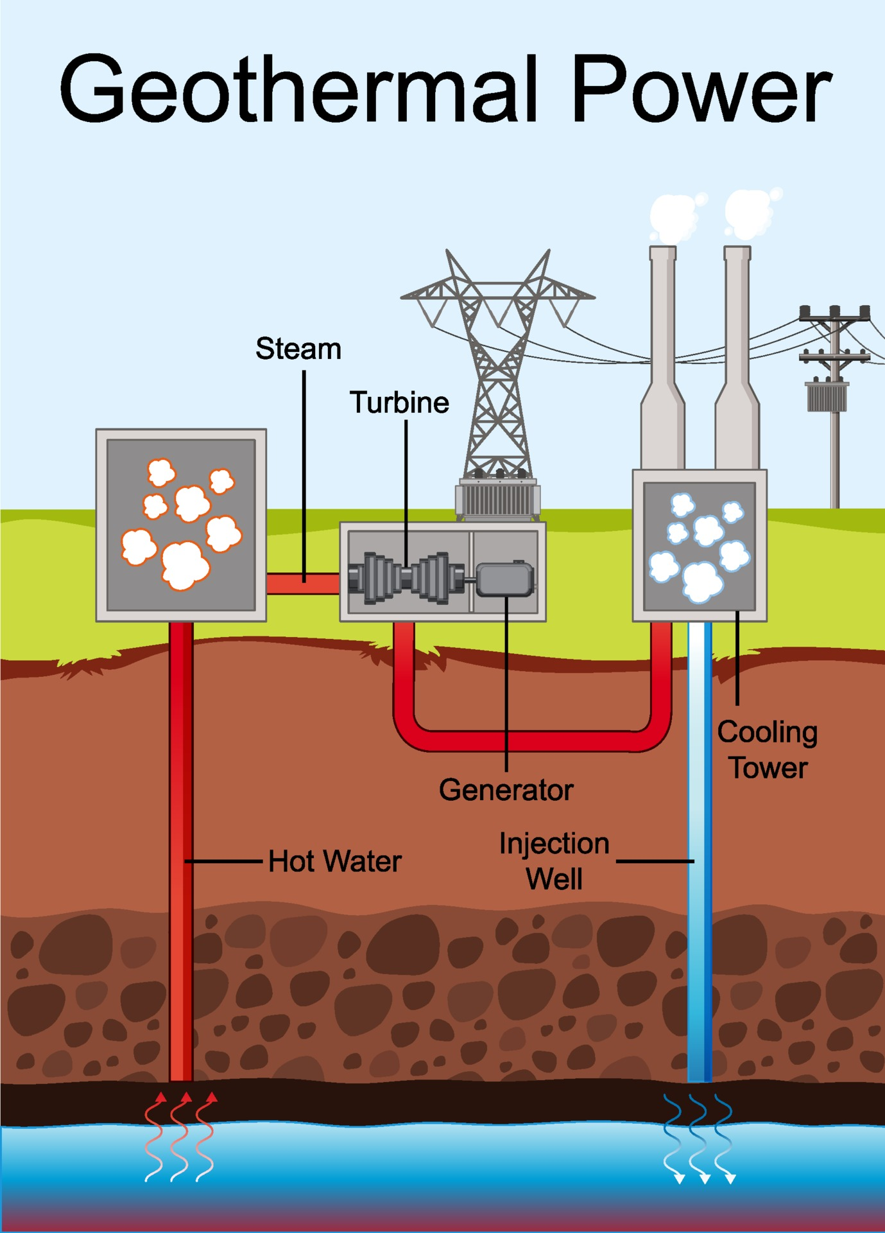
Motivation
r = 10 km
[Küperkoch et al 2018]
https://artpictures.club/autumn-2023.html
Notes:
Recently, geothermal energy is being more and more popular, especially in Germany.
There are more than 40 geothermal power plants are operating.
When it is operating, it extract hot water underground to transfer to energy. On the other hand, it has to inject cold water back to make the ground water resource balance. However, during the operation, researcher found that this process will induce weak to moderate scale earthquakes.
And as you can see in left picture, sometimes the geothermal power plant might build near the residential area. This make the serviceability and comfortability assessment important.

Slide 4
Motivation
Questions:
Will geothermal-induced earthquakes damage the building or make residents uncomfortable?
What is the predominant seismic parameter causing the negative effect on the structures and residents?
r = 10 km
[Küperkoch et al 2018]
https://artpictures.club/autumn-2023.html
Notes:
Therefore, in the thesis, my goal is to answer this two questions.
Will geothermal-induced earthquakes damage the building or make residents uncomfortable?
What is the predominant seismic parameter causing the negative effect on the structures and residents?

Slide 5
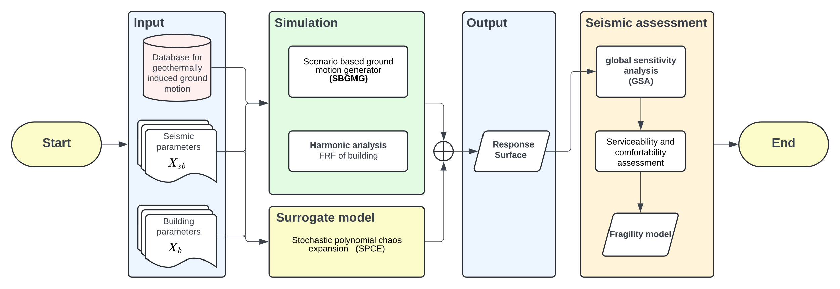
Overall Framework
Notes:
In the presentation, we will first introduce the SBGMG, which can generate the artificial ground motion based on seismic parameters such as moment magnitude and rupture distance, and with the stochasticity.
Following then, I will talk about the SPCE, which is the non-intrusive parametric probability based surrogate model.
After this, I will show a simple case study with the sensitivity analysis then performing the survivability and comfortability assessment on it based on Germany standard code.

Slide 6
Content of presentation
Scenario based ground motion generator
(SBGMG)
Introduction
&
Motivation
Conclusion
&
Outlook
Case study
Stochastic polynomial chaos expansion
(SPCE)
Notes:
In the presentation, we will first introduce the SBGMG, which can generate the artificial ground motion based on seismic parameters such as moment magnitude and rupture distance, and with the stochasticity.
Following then, I will talk about the SPCE, which is the non-intrusive parametric probability based surrogate model.
After this, I will show a simple case study with the sensitivity analysis then performing the survivability and comfortability assessment on it based on Germany standard code.

Slide 7
Scenario based ground motion generator (SBGMG)
Notes:
Let’s talk about the SBGMG first.

Slide 8
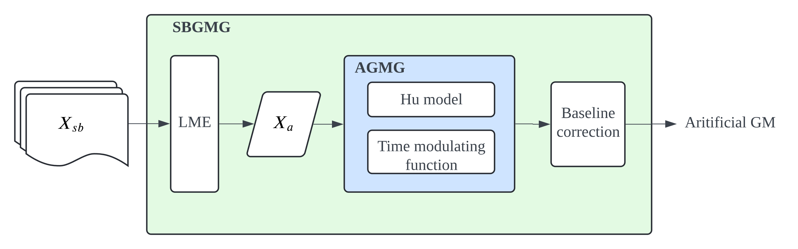
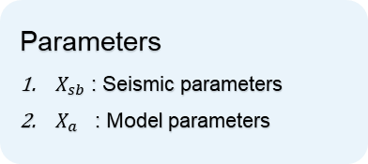
SBGMG Framework
Abbreviation
SBGMG: Scenario based ground motion generator
AGMG: Artificial ground motion generator
Hu model: Spectral stationary Hu-Zhou model
GM: Ground motion
LME: linear mixed effect model
Parameters
$X_{sb}$ : Seismic parameters
$X_{a}$ : Model parameters
Notes:
As you can see, this is the framework of SBGMG.
Here we input the seismic parameters, such as moment magnitude, rupture distance into the generator. Most of the seismic parameters can be imported from the ground motion database. In this thesis, we use the ground motion database from Insheim area.
The seismic parameters will first pass thought the linear mixed effect model, and those seismic parameters will be transfer to model parameter.
Model parameter are the parameter designed for building the AGMG.
When we input the model parameters into the AGMG, which is the package include spectral stationary Hu model and time modulating function.
Once the artificial ground motion is generated, we perform baseline correction to detrend then output the result.
Let focus on the AGMG first.

Slide 9
SBGMG Framework
Abbreviation
SBGMG: Scenario based ground motion generator
AGMG: Artificial ground motion generator
Hu model: Spectral stationary Hu-Zhou model
GM: Ground motion
LME: linear mixed effect model
Parameters
$X_{sb}$ : Seismic parameters
$X_{a}$ : Model parameters
Notes:
As you can see, this is the framework of SMGMG.
Here we input the seismic parameters, such as moment magnitude, rupture distance into the generator. Most of the seismic parameters can be imported from the ground motion database. In this thesis, we use the ground motion database from Insheim area.
The seismic parameters will first pass thought the linear mixed effect model, and those seismic parameters will be transfer to model parameter.
Model parameter are the parameter designed for building the AGMG.
When we input the model parameters into the AGMG, which is the package include spectral stationary Hu model and time modulating function.
Once the artificial ground motion is generated, we perform baseline correction to detrend then output the result.
Let focus on the AGMG first.

Slide 10
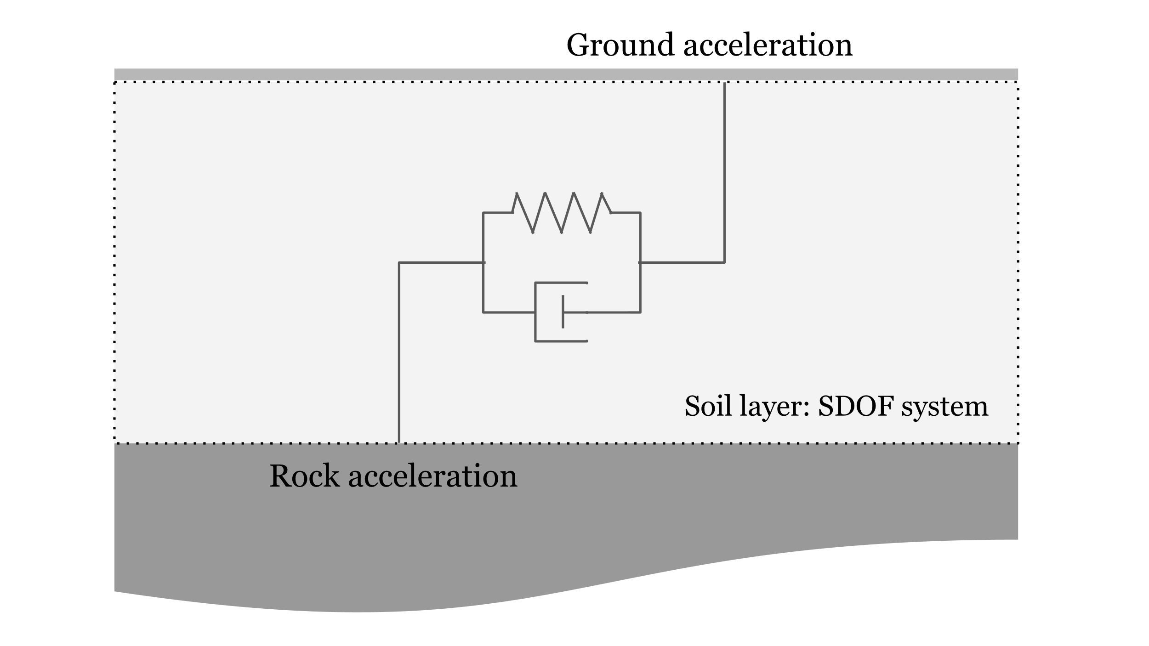
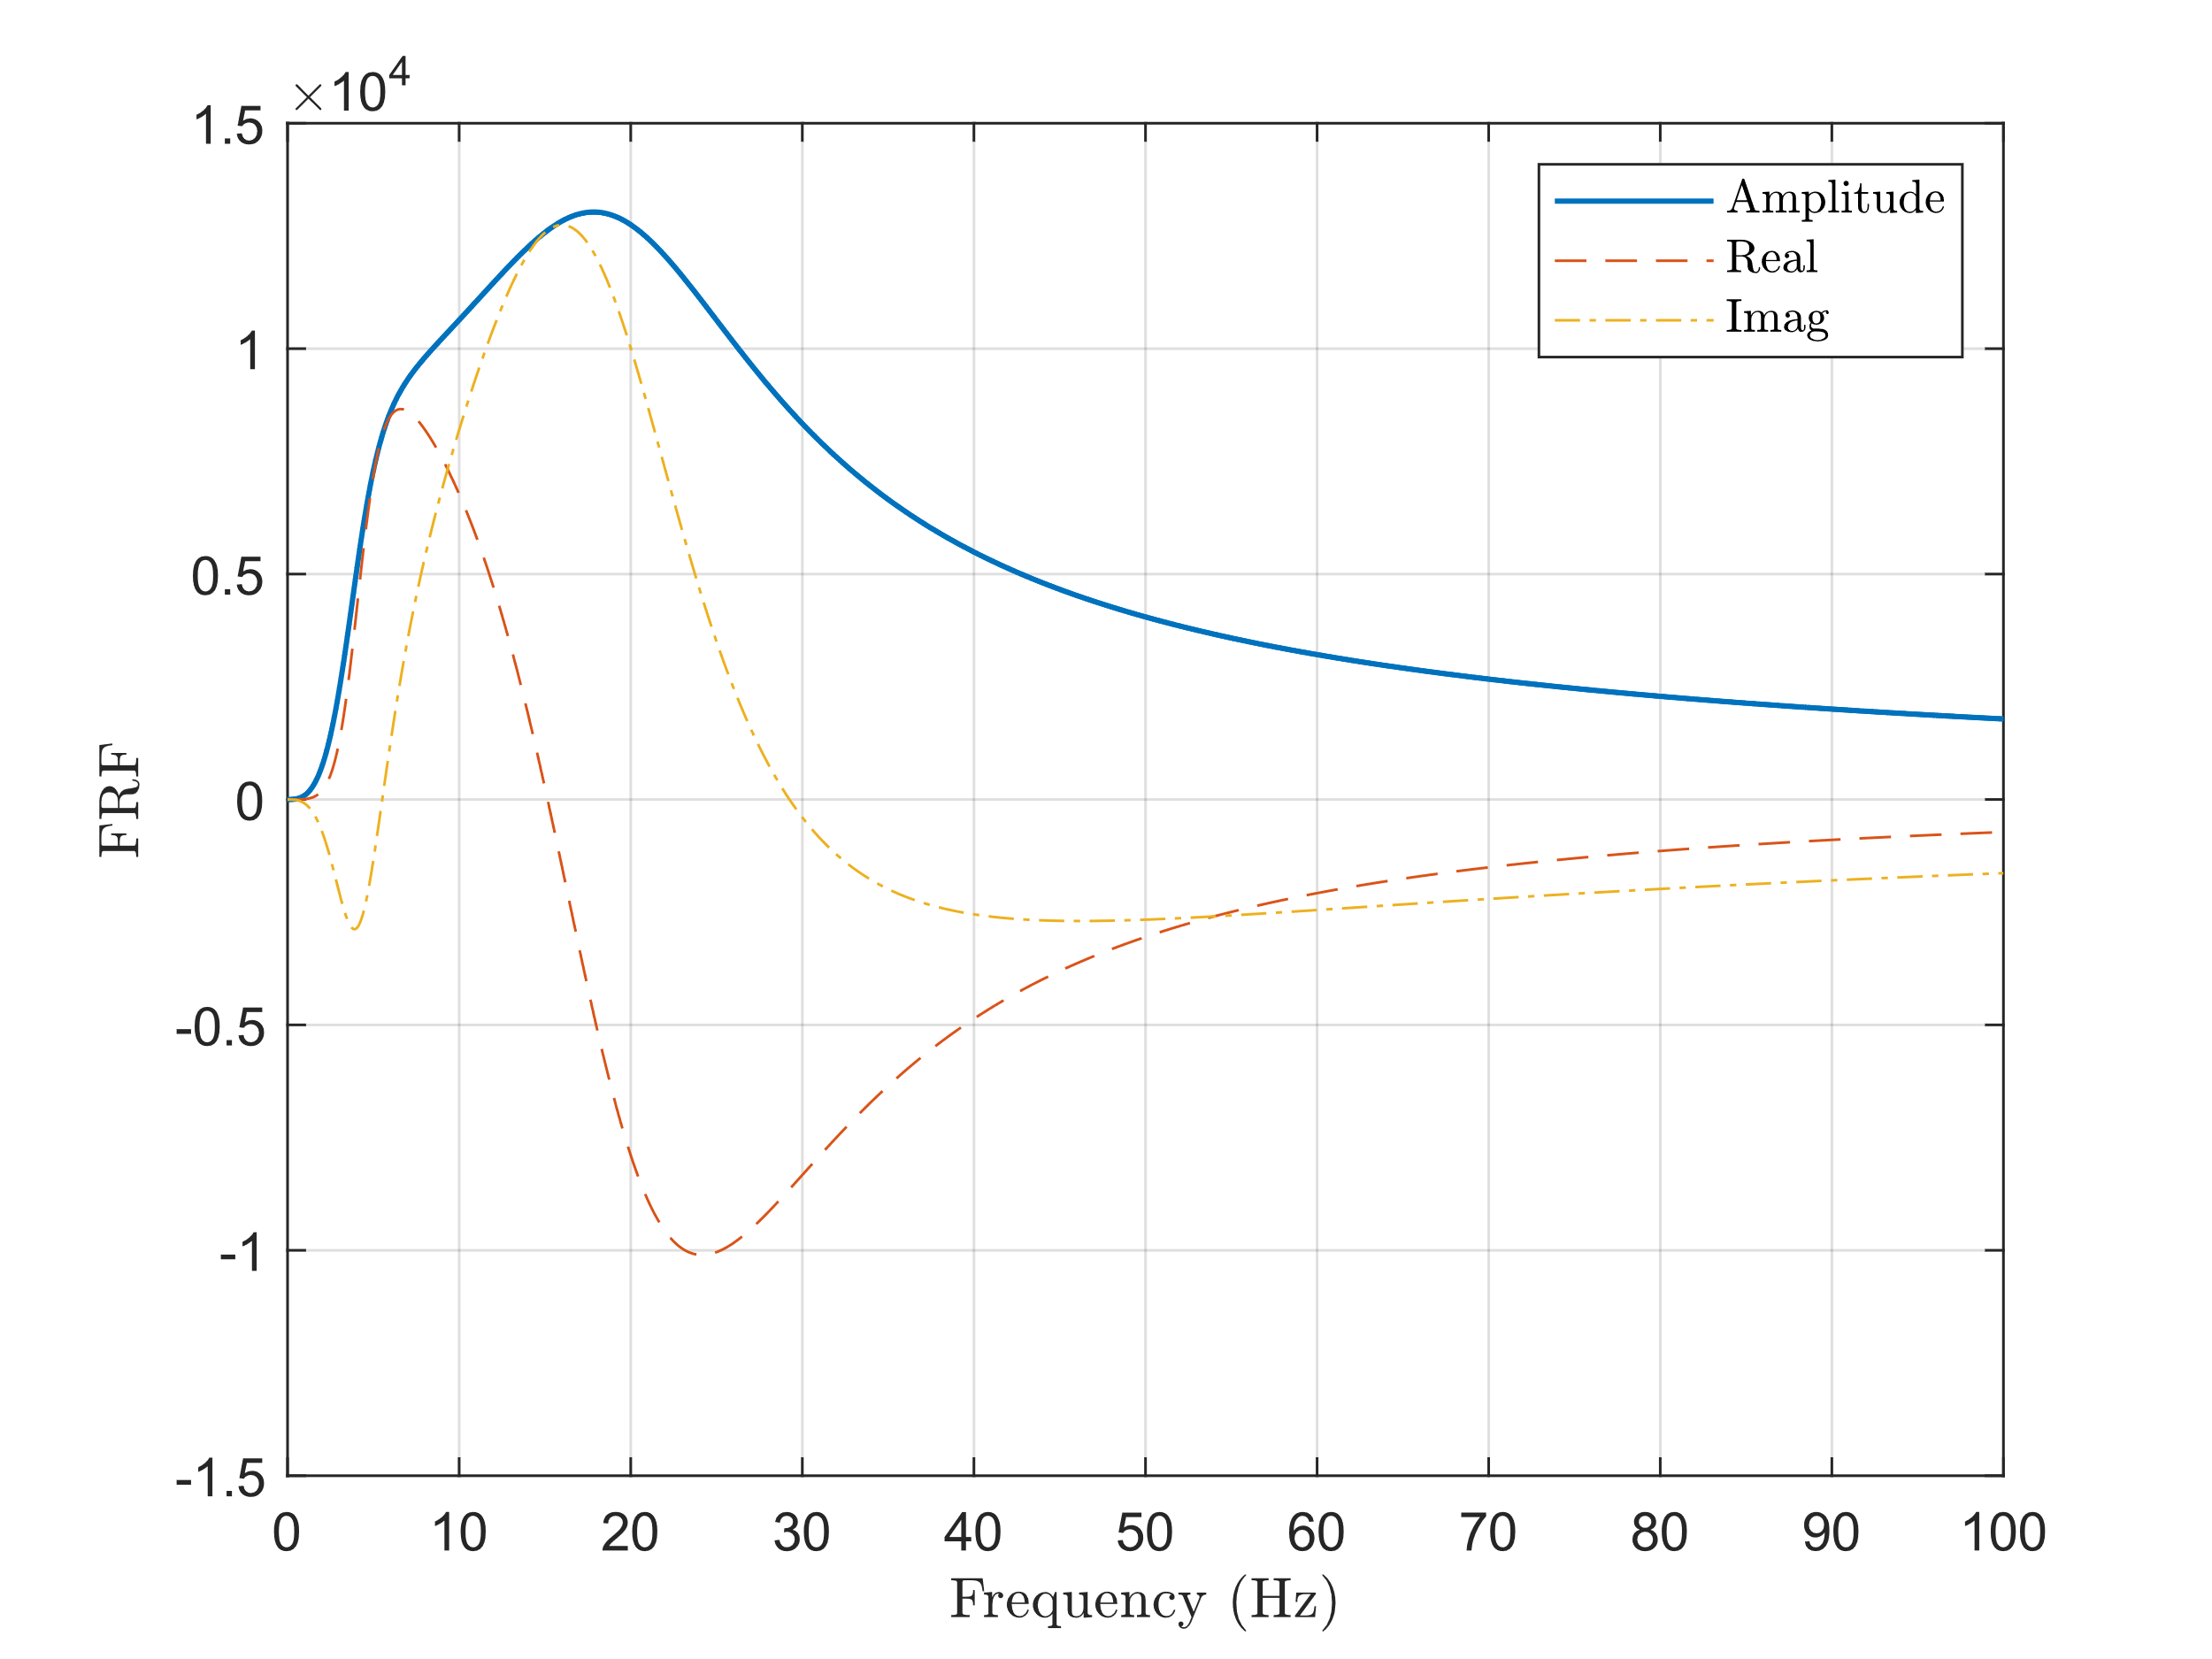
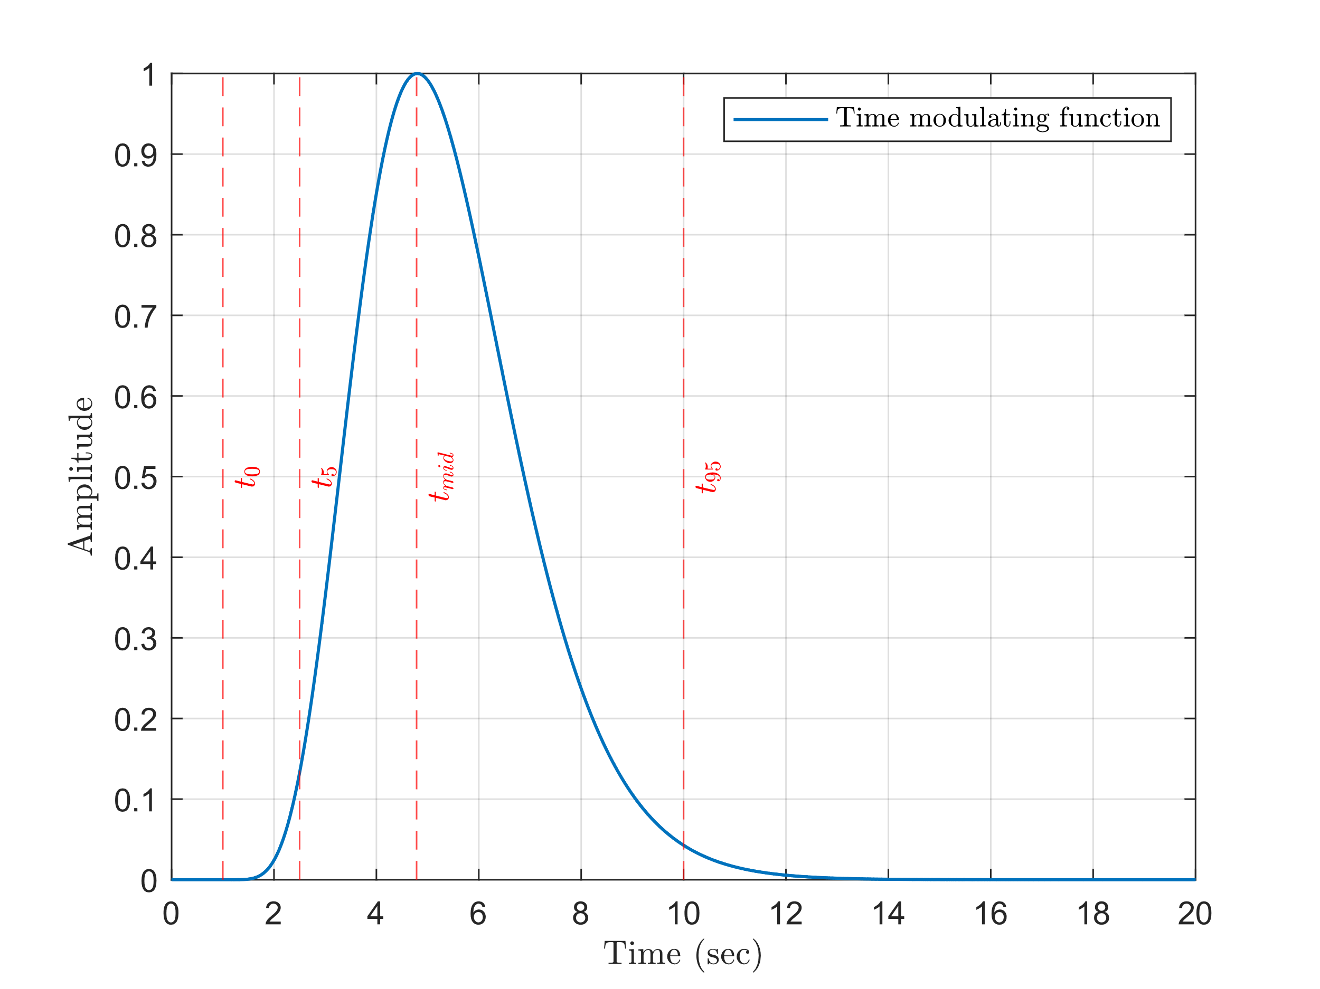
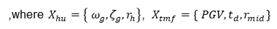


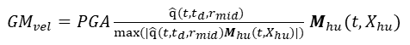
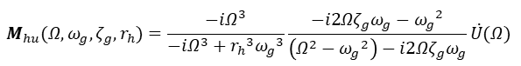
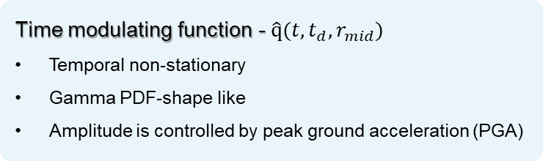
AGMG Model
Hu model - $M_{hu}$($Ω,ω_{g},ζ_{g},r_{h}$)
Spectral stationary
Excited by Gaussian color noise
The soil layer is a linear SDOF system
FRF of Hu model
GWN
Time modulating function - $\hat{q}(t, t_{d},r_{mid})$
Temporal non-stationary
Gamma PDF-shape like
Amplitude is controlled by peak ground acceleration (PGA)
$$M_{hu}(Ω,ω_{g},ζ_{g},r_{h})=\frac{−iΩ^{3}}{−iΩ^{3}+{r_{h}}^{3}{ω_{g}}^{3}}\frac{−i2Ωζ_{g}ω_{g}−{ω_{g}}^{2}}{\left(Ω^{2}−{ω_{g}}^{2}\right)−i2Ωζ_{g}ω_{g}}\ddot{U}(Ω)$$
IFFT
${GM}_{vel}=PGA\frac{\hat{q}(t, t_{d},r_{mid}) }{max⁡(|\hat{q}(t, t_{d},r_{mid})M_{hu}(t,X_{hu})|)}$ $M_{hu}(t,X_{hu})$
Time modulating function
$$X_{a}=\left\{ X_{hu} ;X_{tmf}\right\}$$
,where $X_{hu}=\left\{ ω_{g},{\text{ζ}}_{g},r_{h}\right\}$, $X_{tmf}=\{ PGV, t_{d},r_{mid}\}$
Notes:
In AGMG, there are two parts, which are Hu model and Time modulating function.
In Hu model, we assume the soil layer is the SDOF system, which is controlled by predominated frequency, omega and damping ratio, zeta.
The rock acceleration is Gaussian white noise filtering by the high-pass filter, where the cutoff frequency is controlled by rh.
For time modulating function, it is a gamma-probability-density-function-shape-like curve which is controlled by the duration and the time where the largest amplitude occurs.
When we build the Frequency response function of Hu model, we dot product it with Gaussian white noise in frequency domain then transfer it back to time domain by IFFT. After this, we dot product it with time modulating function again then normalized it.
In the end, we control the amplitude of this ground motion by peak ground acceleration.

Slide 11
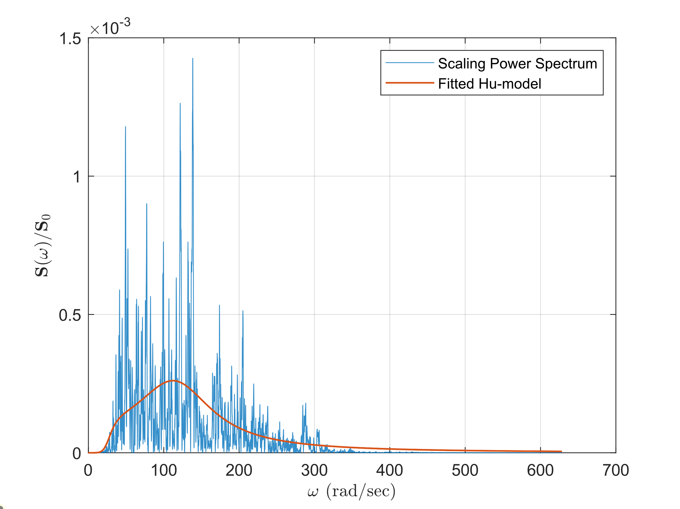
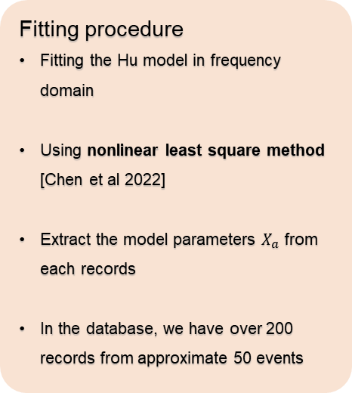
Extract model parameters $X_{a}$
Fitting procedure
Fitting the Hu model in frequency domain
Using nonlinear least square method [Chen et al 2022]
Extract the model parameters $X_{a}$ from each records
In the database, we have over 200 records from approximate 50 events
Notes:
Here is the flow chart of it.
The modal parameters for building AGMG can be first extracted by nonlinear least square method. And we build the frequency response function based on recorded ground motion.

Slide 12
SBGMG Framework
Abbreviation
SBGMG: Scenario based ground motion generator
AGMG: Artificial ground motion generator
Hu model: Spectral stationary Hu-Zhou model
GM: Ground motion
LME: linear mixed effect model
Parameters
$X_{sb}$ : Seismic parameters
$X_{a}$ : Model parameters
Notes:
As you can see, this is the framework of SMGMG.
Here we input the seismic parameters, such as moment magnitude, rupture distance into the generator. Most of the seismic parameters can be imported from the ground motion database. In this thesis, we use the ground motion database from Insheim area.
The seismic parameters will first pass thought the linear mixed effect model, and those seismic parameters will be transfer to model parameter.
Model parameter are the parameter designed for building the AGMG.
When we input the model parameters into the AGMG, which is the package include spectral stationary Hu model and time modulating function.
Once the artificial ground motion is generated, we perform baseline correction to detrend then output the result.
Let focus on the AGMG first.

Slide 13
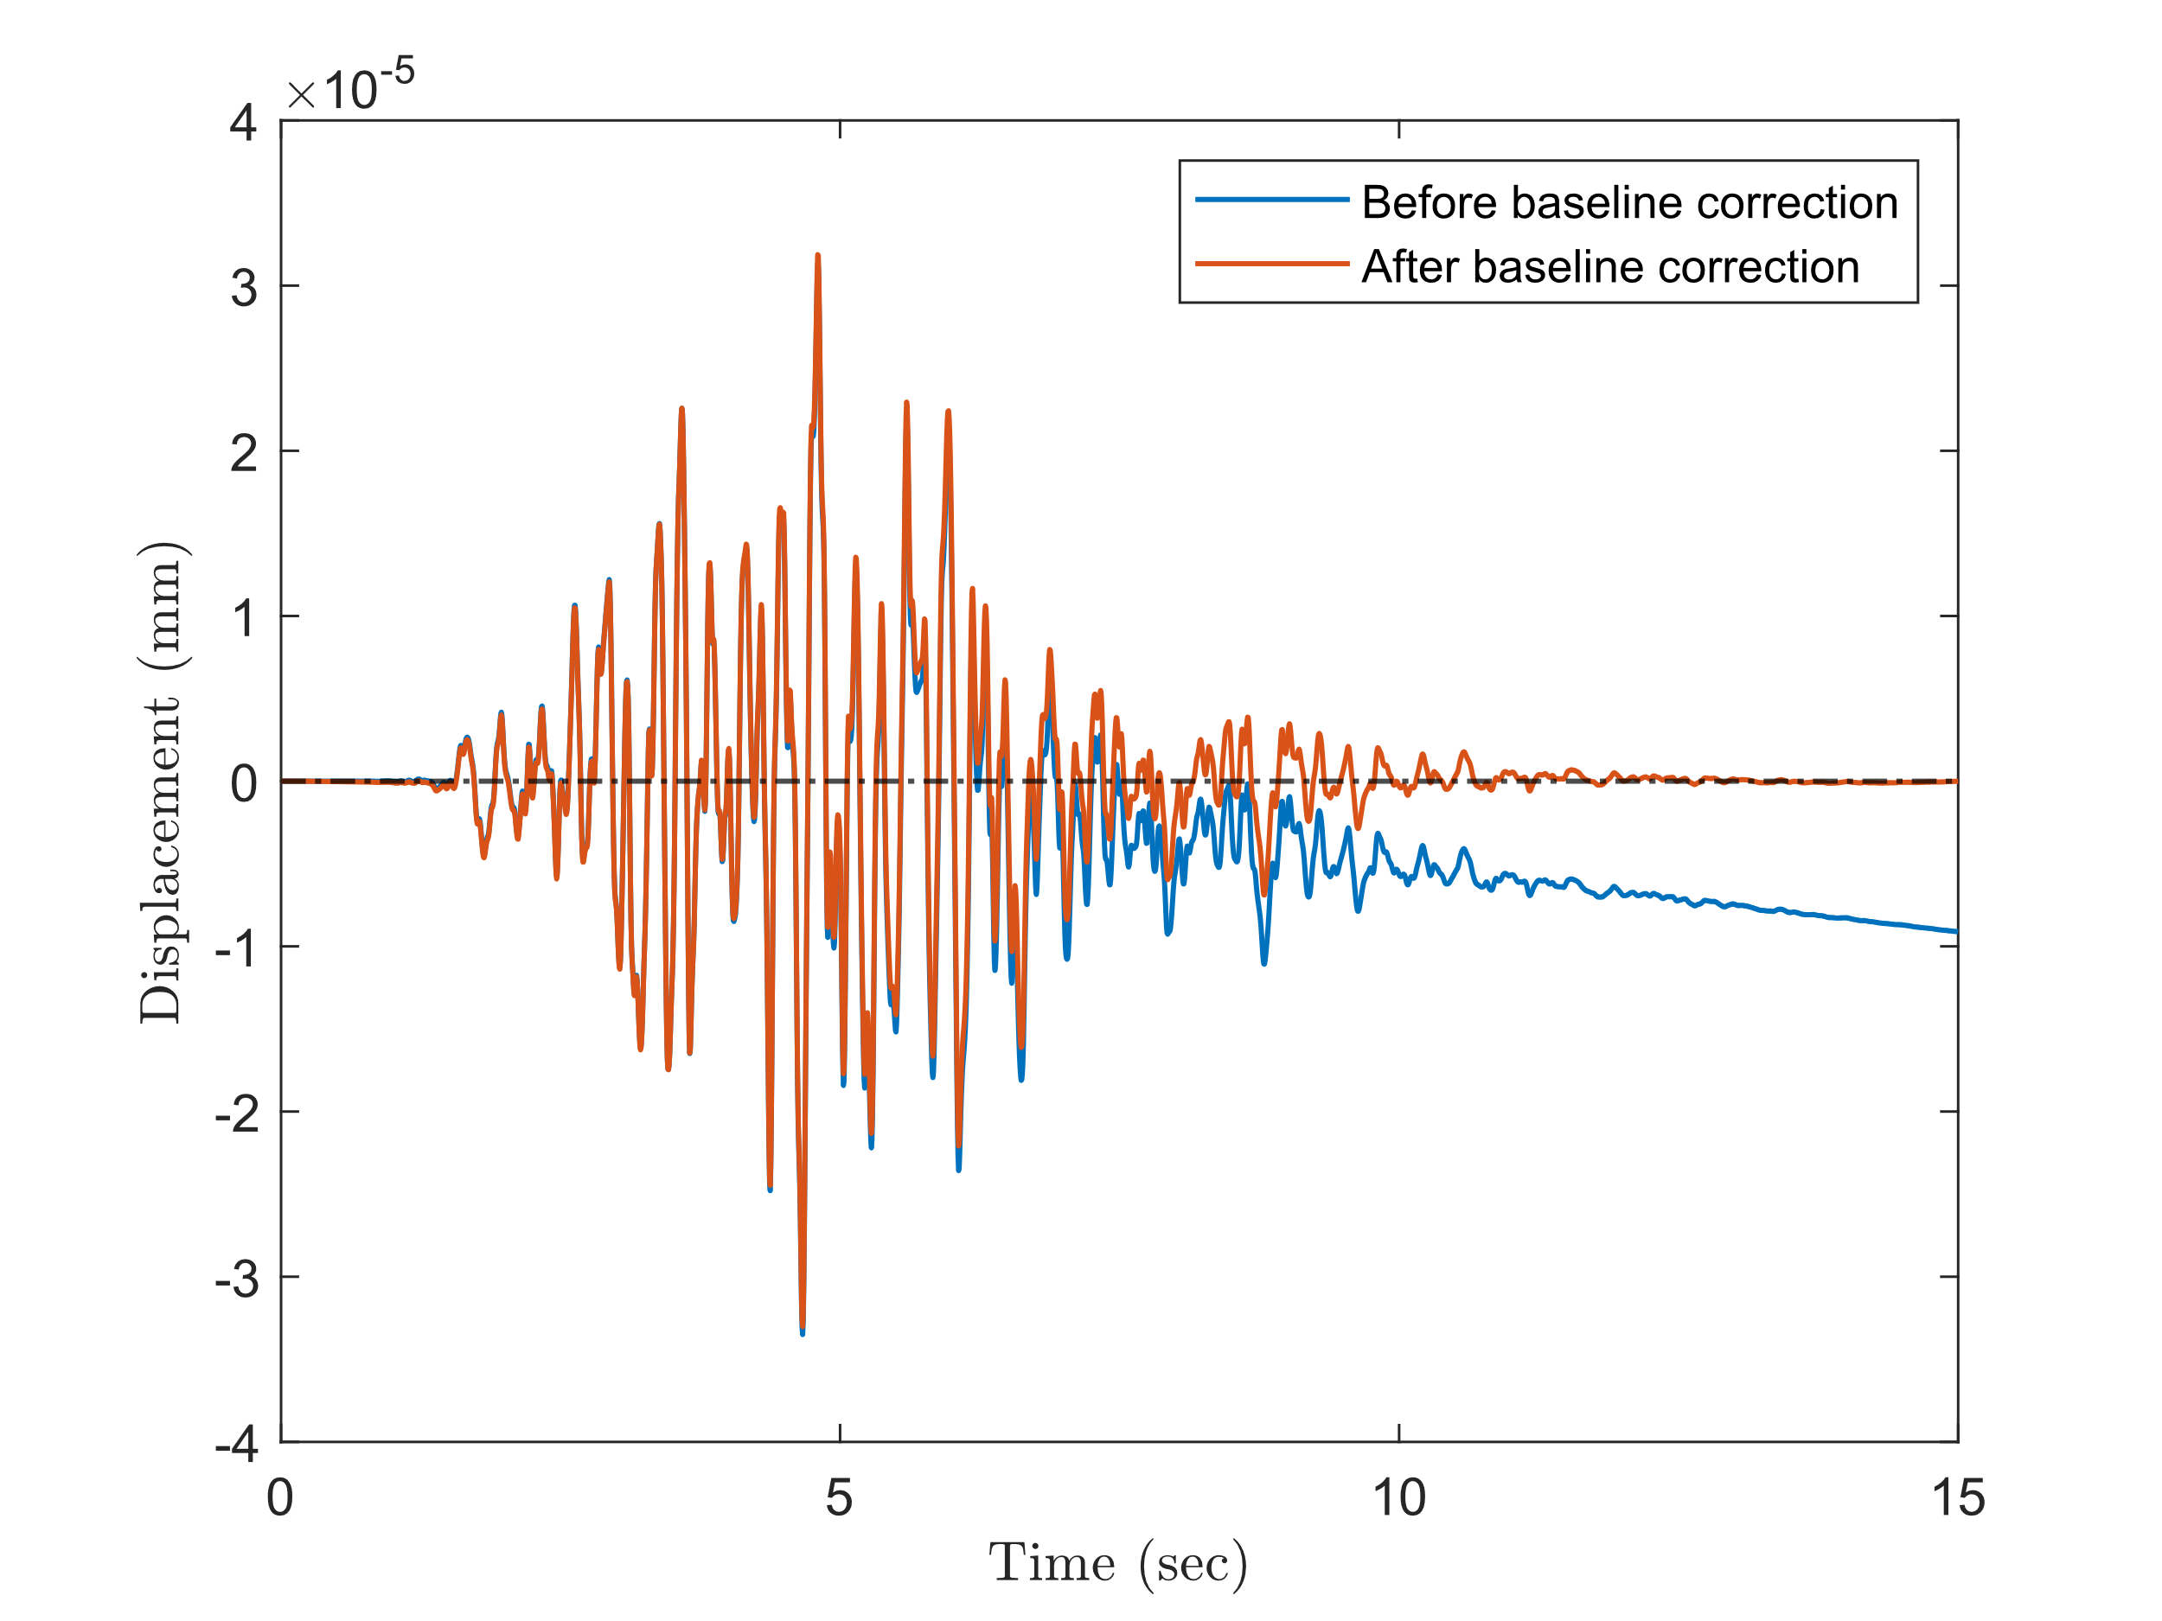
Baseline correction
Baseline correction
Proposed by [Pan et al 2016], written in MATLAB toolbox.
Detrend acceleration, velocity, and displacement signals simultaneously.
Trends are fitted by high order polynomials, using least square method.
Notes:
After this, we perform baseline correction.

Slide 14
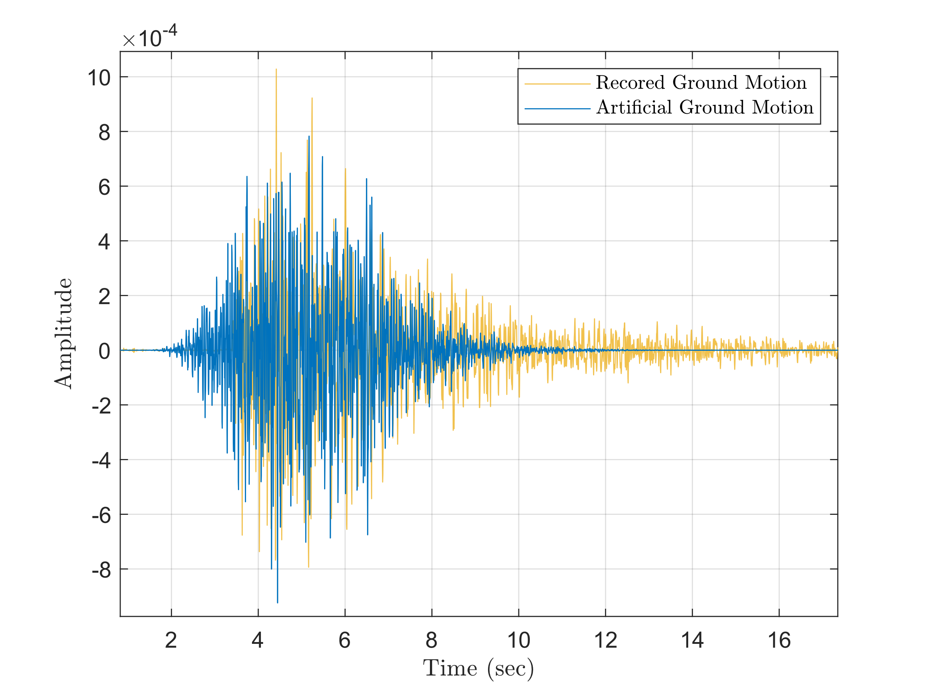
Comparison of artificial GM with recorded one
Notes:
And we can get the artificial ground motion like recorded one.

Slide 15
SBGMG Framework
Abbreviation
SBGMG: Scenario based ground motion generator
AGMG: Artificial ground motion generator
Hu model: Spectral stationary Hu-Zhou model
GM: Ground motion
LME: linear mixed effect model
Parameters
$X_{sb}$ : Seismic parameters
$X_{a}$ : Model parameters
Notes:
As you can see, this is the framework of SMGMG.
Here we input the seismic parameters, such as moment magnitude, rupture distance into the generator. Most of the seismic parameters can be imported from the ground motion database. In this thesis, we use the ground motion database from Insheim area.
The seismic parameters will first pass thought the linear mixed effect model, and those seismic parameters will be transfer to model parameter.
Model parameter are the parameter designed for building the AGMG.
When we input the model parameters into the AGMG, which is the package include spectral stationary Hu model and time modulating function.
Once the artificial ground motion is generated, we perform baseline correction to detrend then output the result.
Let focus on the AGMG first.

Slide 16
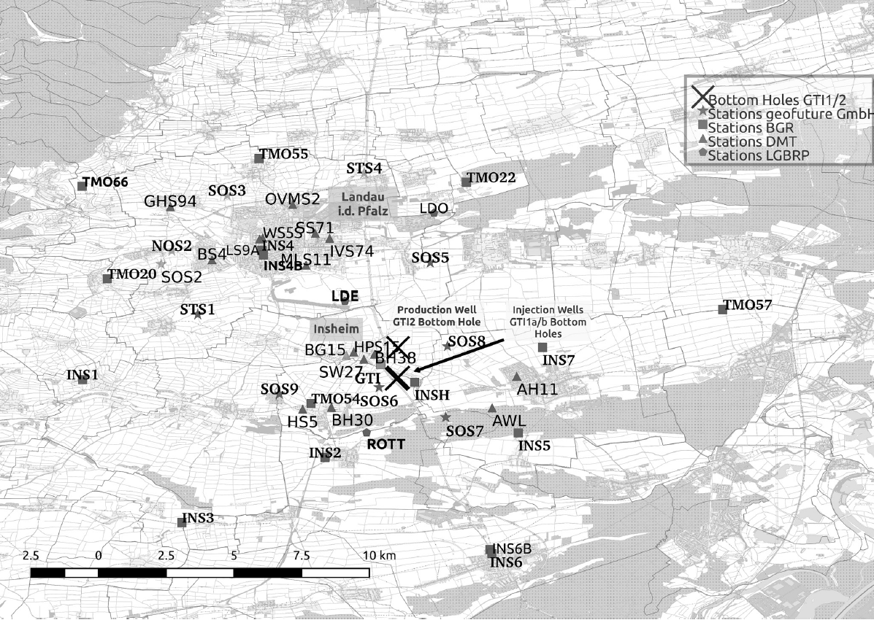
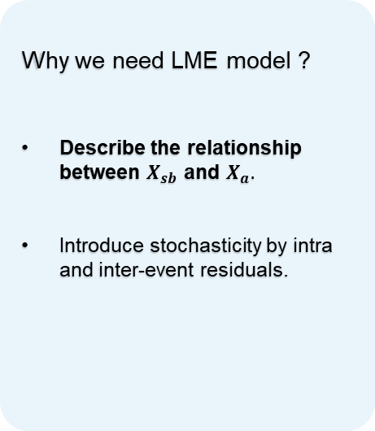
Linear mixed effect model (LME)
Why we need LME model ?
Describe the relationship between $X_{sb}$ and $X_{a}.$
Introduce stochasticity by intra and inter-event residuals.
[Küperkoch et al 2018]
Inter-event: within a single event or group
Intra-event: between different events or groups
Notes:
Linear mixed effect model is similar to linear regression model that can describe the relationship between seismic parameter and model parameter.
The reason why we used linear mixed effect model instead of simple linear regression one is because:
Usually, when earthquake occurs, there are several seismic stations will record the ground motions, which mean each event might have several different results based on different rupture distances of the stations.

Slide 17
SBGMG Framework
Validation:
Response spectral analysis
Notes:
After we apply the SBGMG, I tried to validate it by response spectral analysis.

Slide 18
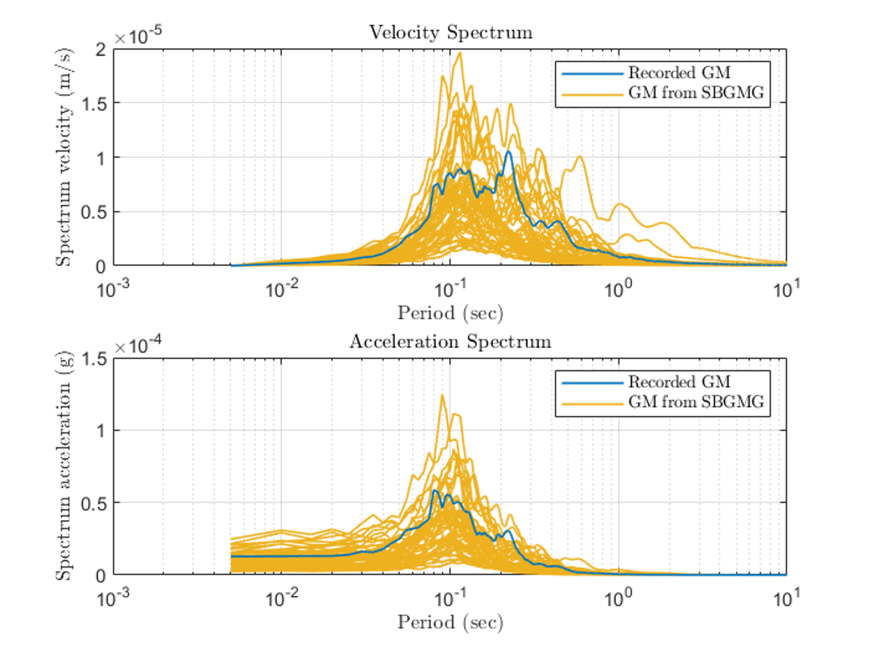
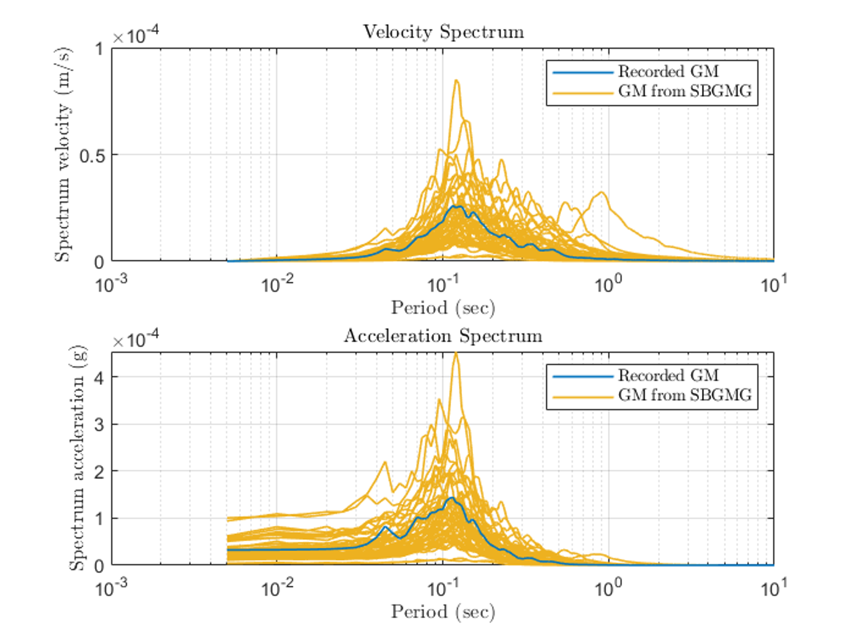
Response spectral analysis
Recorded at 20:40:15 on November 3rd, 2021, from the seismic station INS8, Insheim, Germany.
Recorded at 16:28:45 on February 26th, 2021, from the seismic station TMO20, Insheim, Germany.
Notes:
Here, there are two examples that I compare the recorded ground motion with 50 artificial one from the SBGMG using same seismic parameters, which they show the similar pattern and the recorded ground motions are coved by artificial one.

Slide 19
Stochastic Polynomial Chaos Expansion (SPCE)
Notes:
Then let’s talk about SPCE

Slide 20
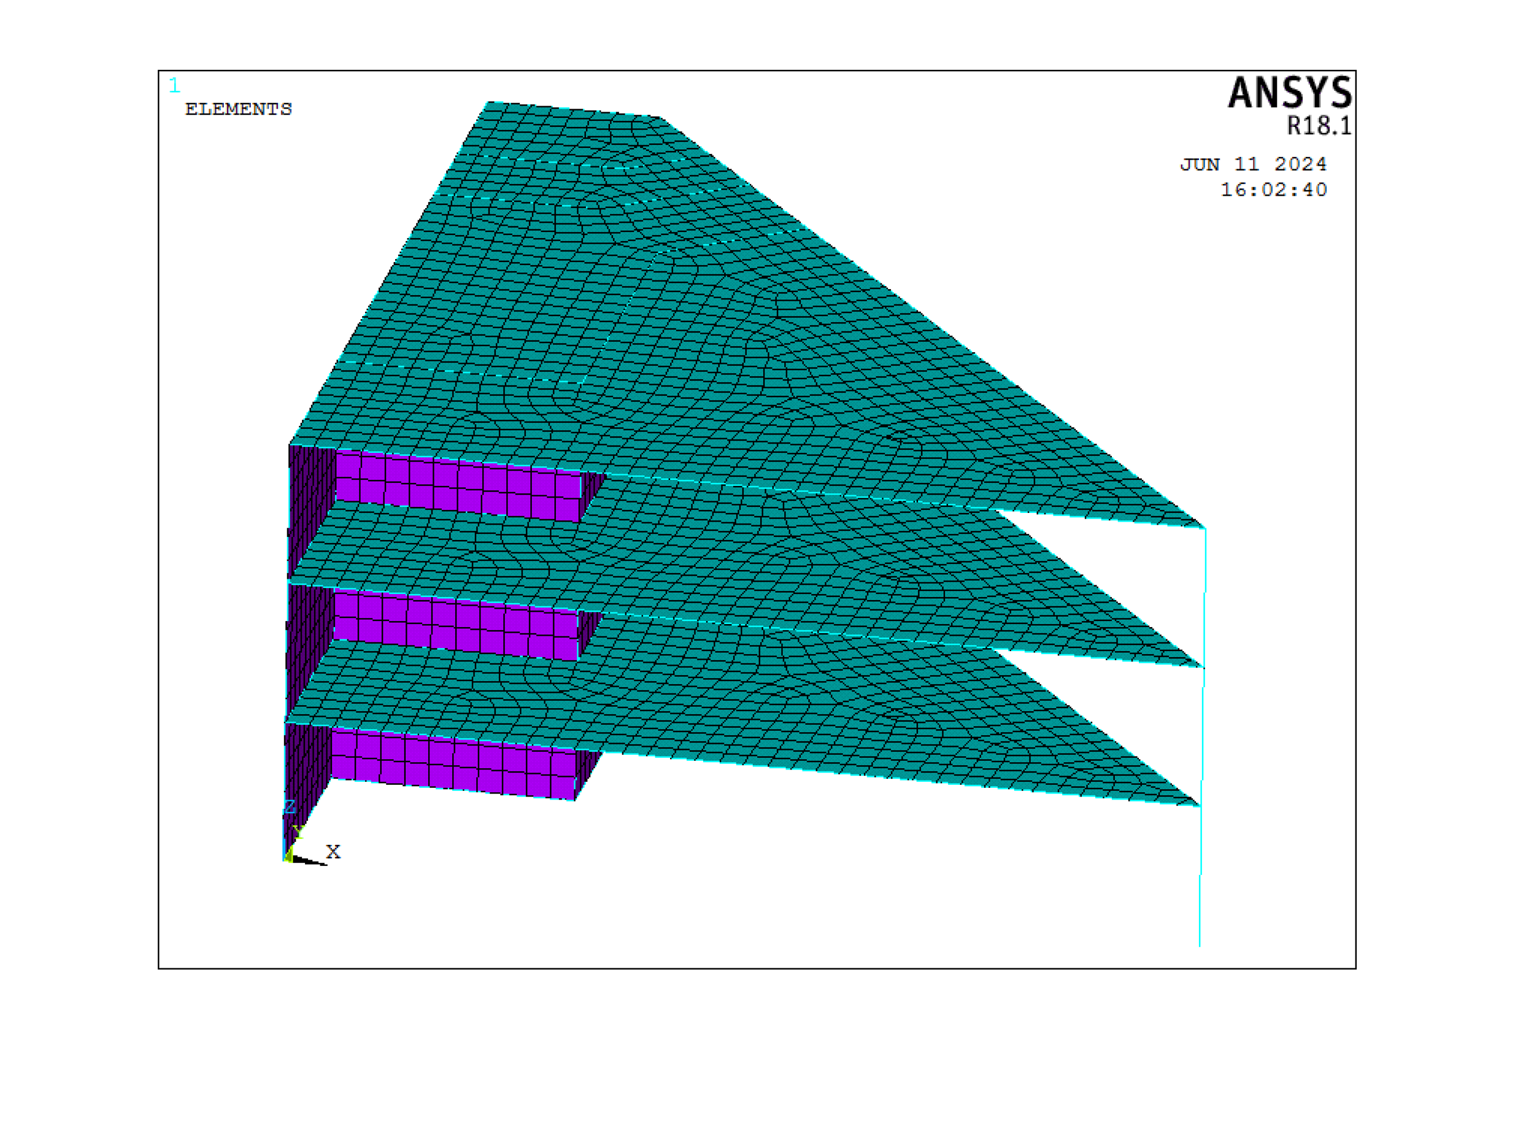



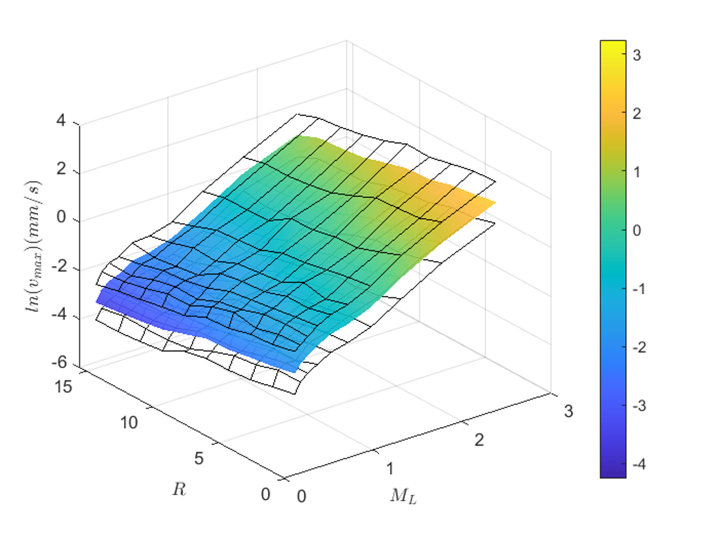
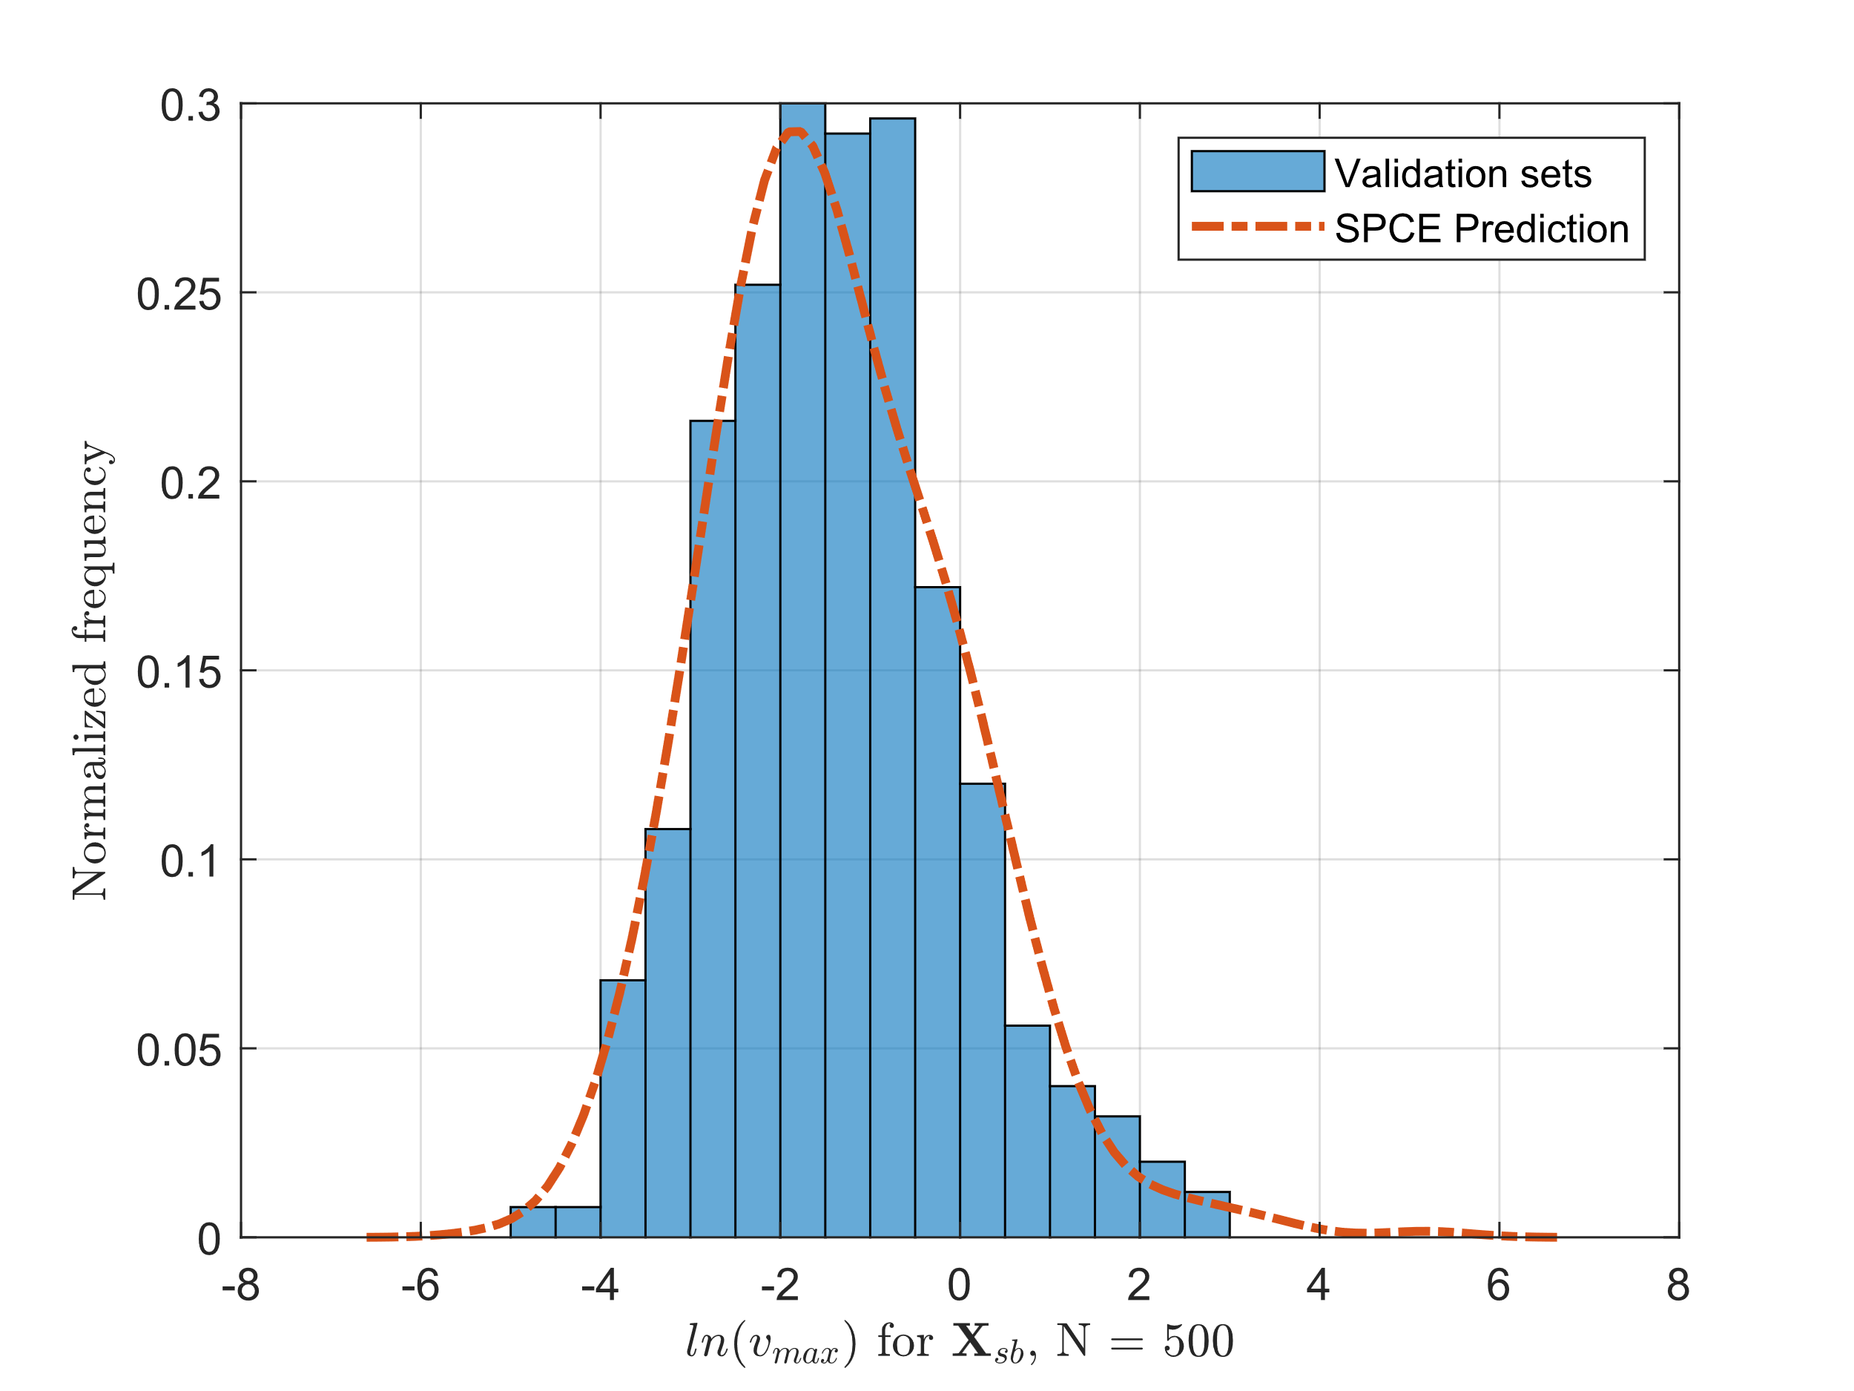
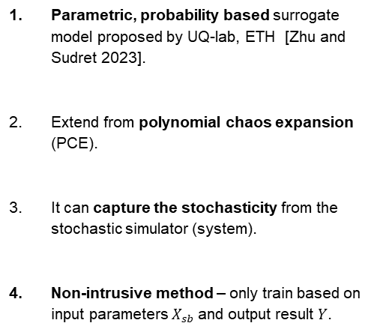
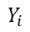
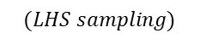
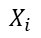
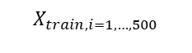
SPCE surrogate model
$$X_{train,i=1,…,500}$$
$$X_{i}$$
$$(LHS sampling)$$
Parametric, probability based surrogate model proposed by UQ-lab, ETH [Zhu and Sudret 2023].
Extend from polynomial chaos expansion (PCE).
It can capture the stochasticity from the stochastic simulator (system).
Non-intrusive method – only train based on input parameters $X_{sb}$and output result $Y$.
$$X_{i}$$
SPCE
$$Y_{i}$$
SPCE
Notes:
SPCE surrogate model is developed by UQ lab from ETH.
It is the extension version of PCE. However, PCE can only capture the uncertainty from the input parameter but can not deal with the stochasticity in the system.
Therefore, SPCE is introduced to deal with it.
The advantage of SPCE is that:
First, it is non-intrusive method, which mean we don’t need to do any modification on the problem itself. What we need it for training is only the input design sets and their corresponding results.
Second, PCE is well known that it is easy to implement global sensitivity analysis, so does SPCE.

Slide 21
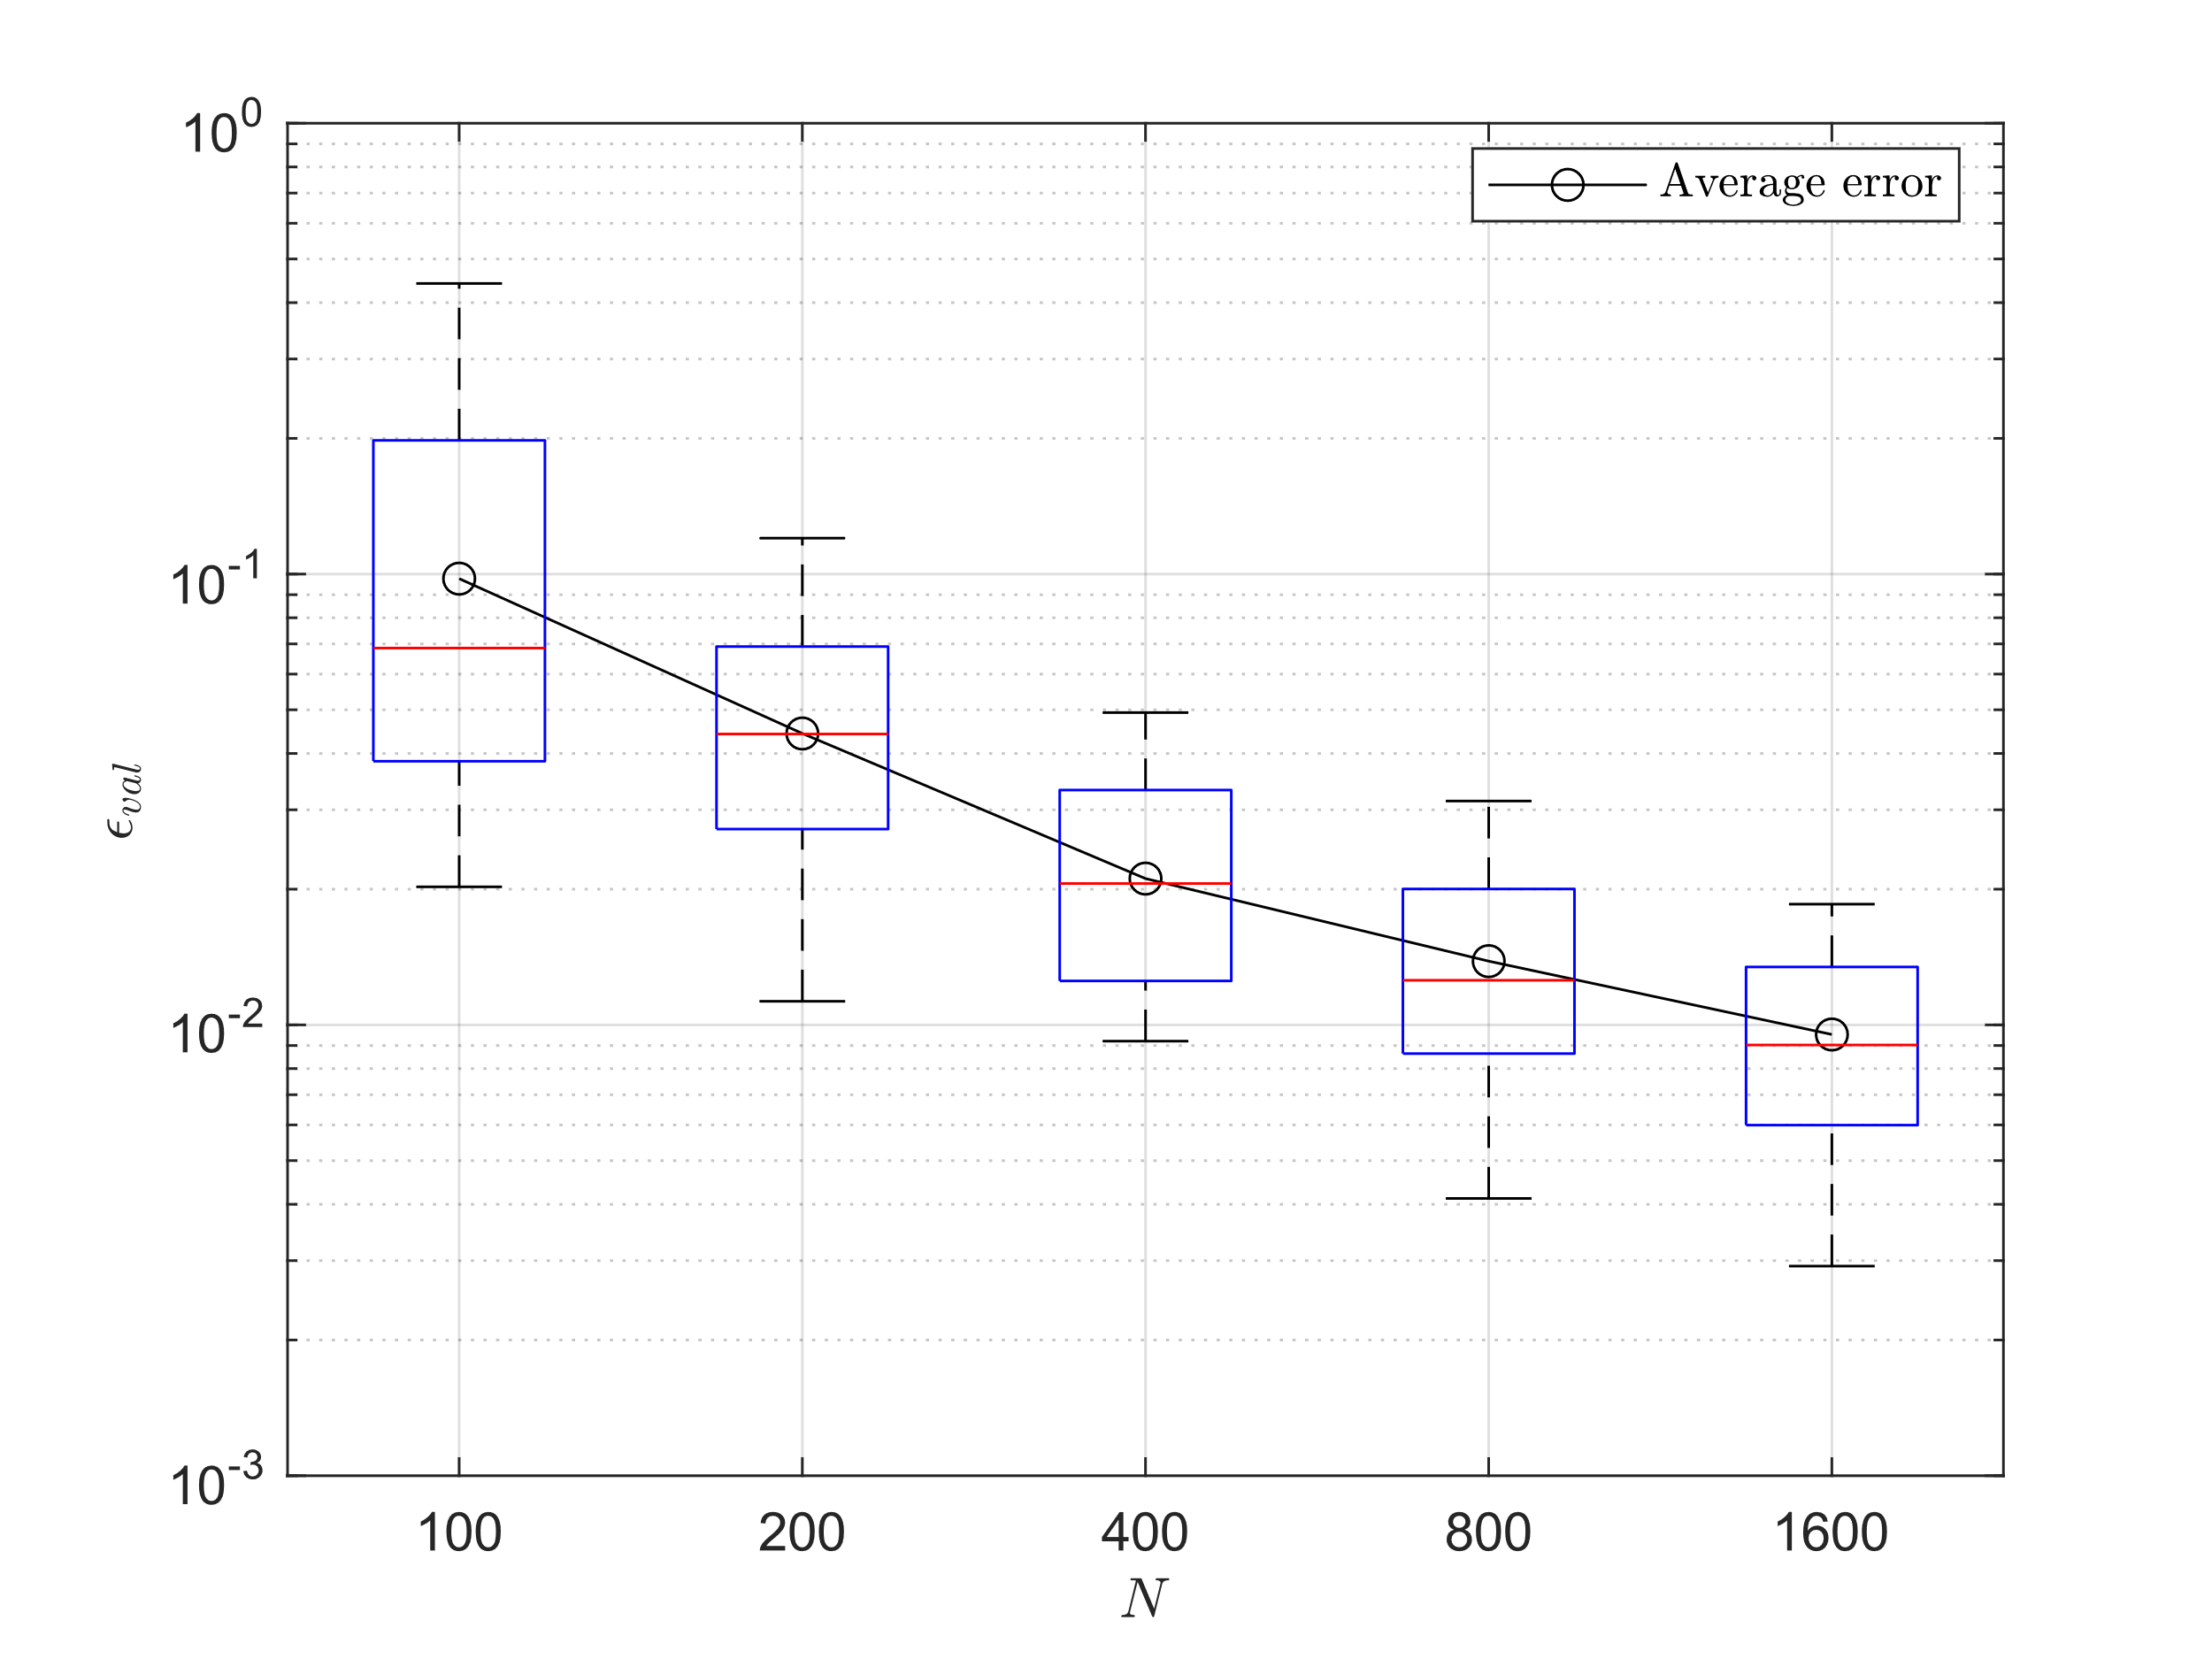
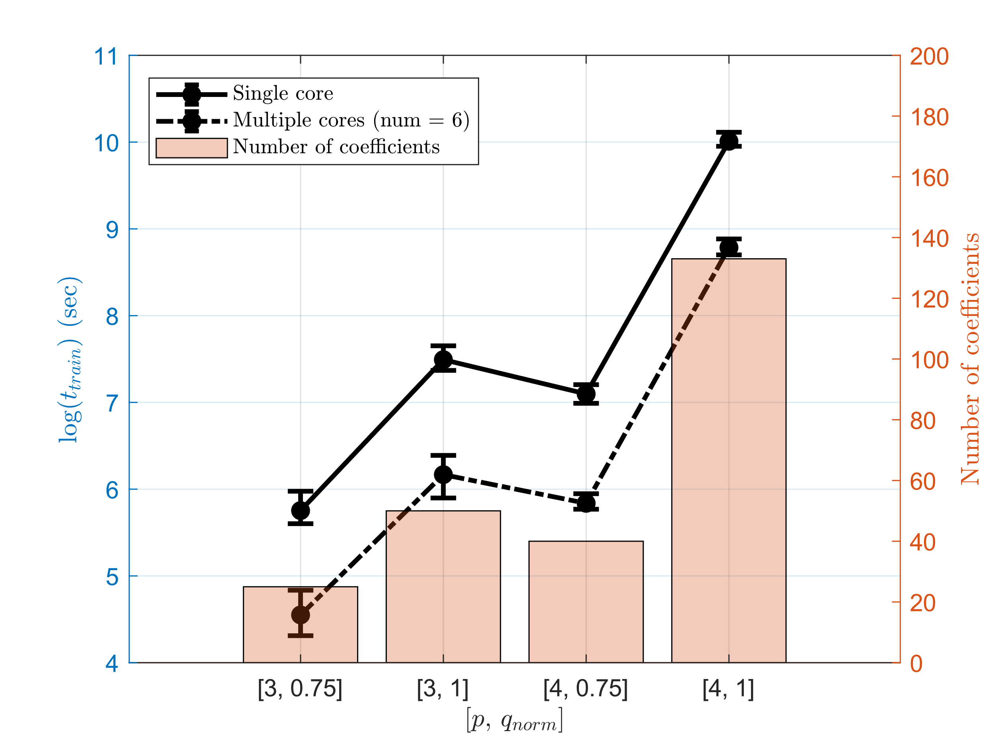
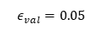
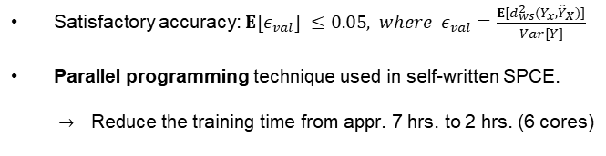
SPCE convergence and training time
Computer specification
CPU | AMD Ryzen 9 3900XT 12-Core Processor
CPU speed | 3.80 GHz
RAM | 32.0 GB
Satisfactory accuracy: $E{[ε}_{val}] ≤0.05, where ε_{val}=\frac{E[d_{ws}^{2}(Y_{x},{\hat{Y}}_{X})]}{Var[Y]}$
Parallel programming technique used in self-written SPCE.
$→$Reduce the training time from appr. 7 hrs. to 2 hrs. (6 cores)
$$ε_{val}=0.05$$
Error convergence
Training time comparison
Notes:
In my thesis, we compute the error using mean of Wasserstein distance of order of two then normalized it with variance. The Wasserstein distance describes the distance between two probability distribution. Here we assume that the satisfactory accuracy is reached when error is smaller than 0.05.
In my self-written SPCE, I also used the parallel programming technique for Gaussian process.
Here I trained the model using 6 cores under this computer spec, it can speed up the training process from 6,8 hours to 1.8 hours, which is more than 3 times faster.

Slide 22
Case study
Notes:
Here is the case study.

Slide 23
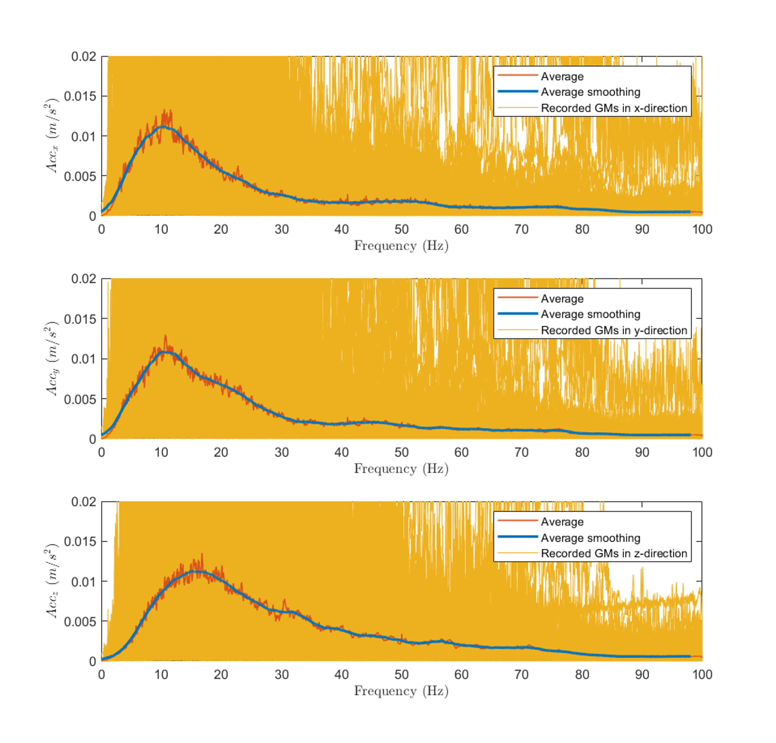
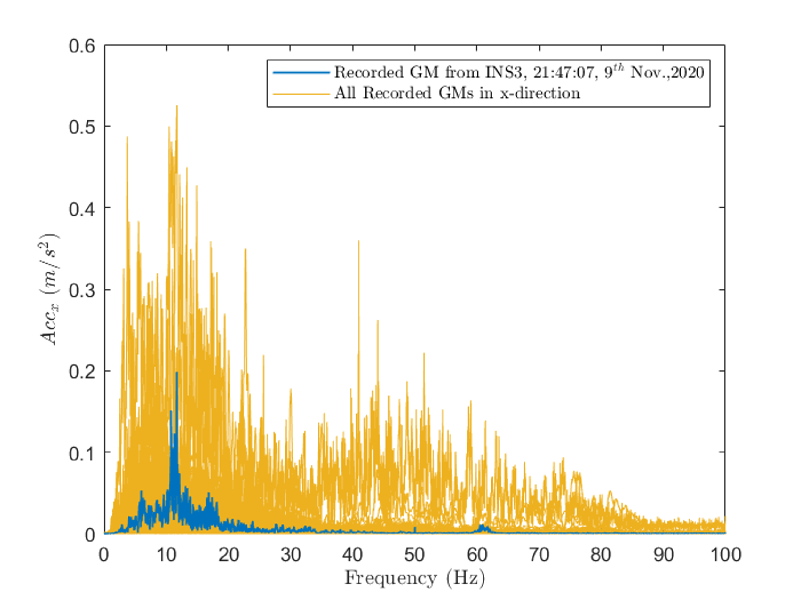
Case study
*Average window size of 250
Similar shape
FRF of Hu model
Ground motion database from Insheim, Germany
Notes:
In the case study, we use the ground motion database for Insheim area to train SBGMG. There are more than 200 records in the database.
In the right figure, I tried to visualized the mean of all ground motion and compare with FRF function of Hu model, you can see it looks pretty similar.

Slide 24
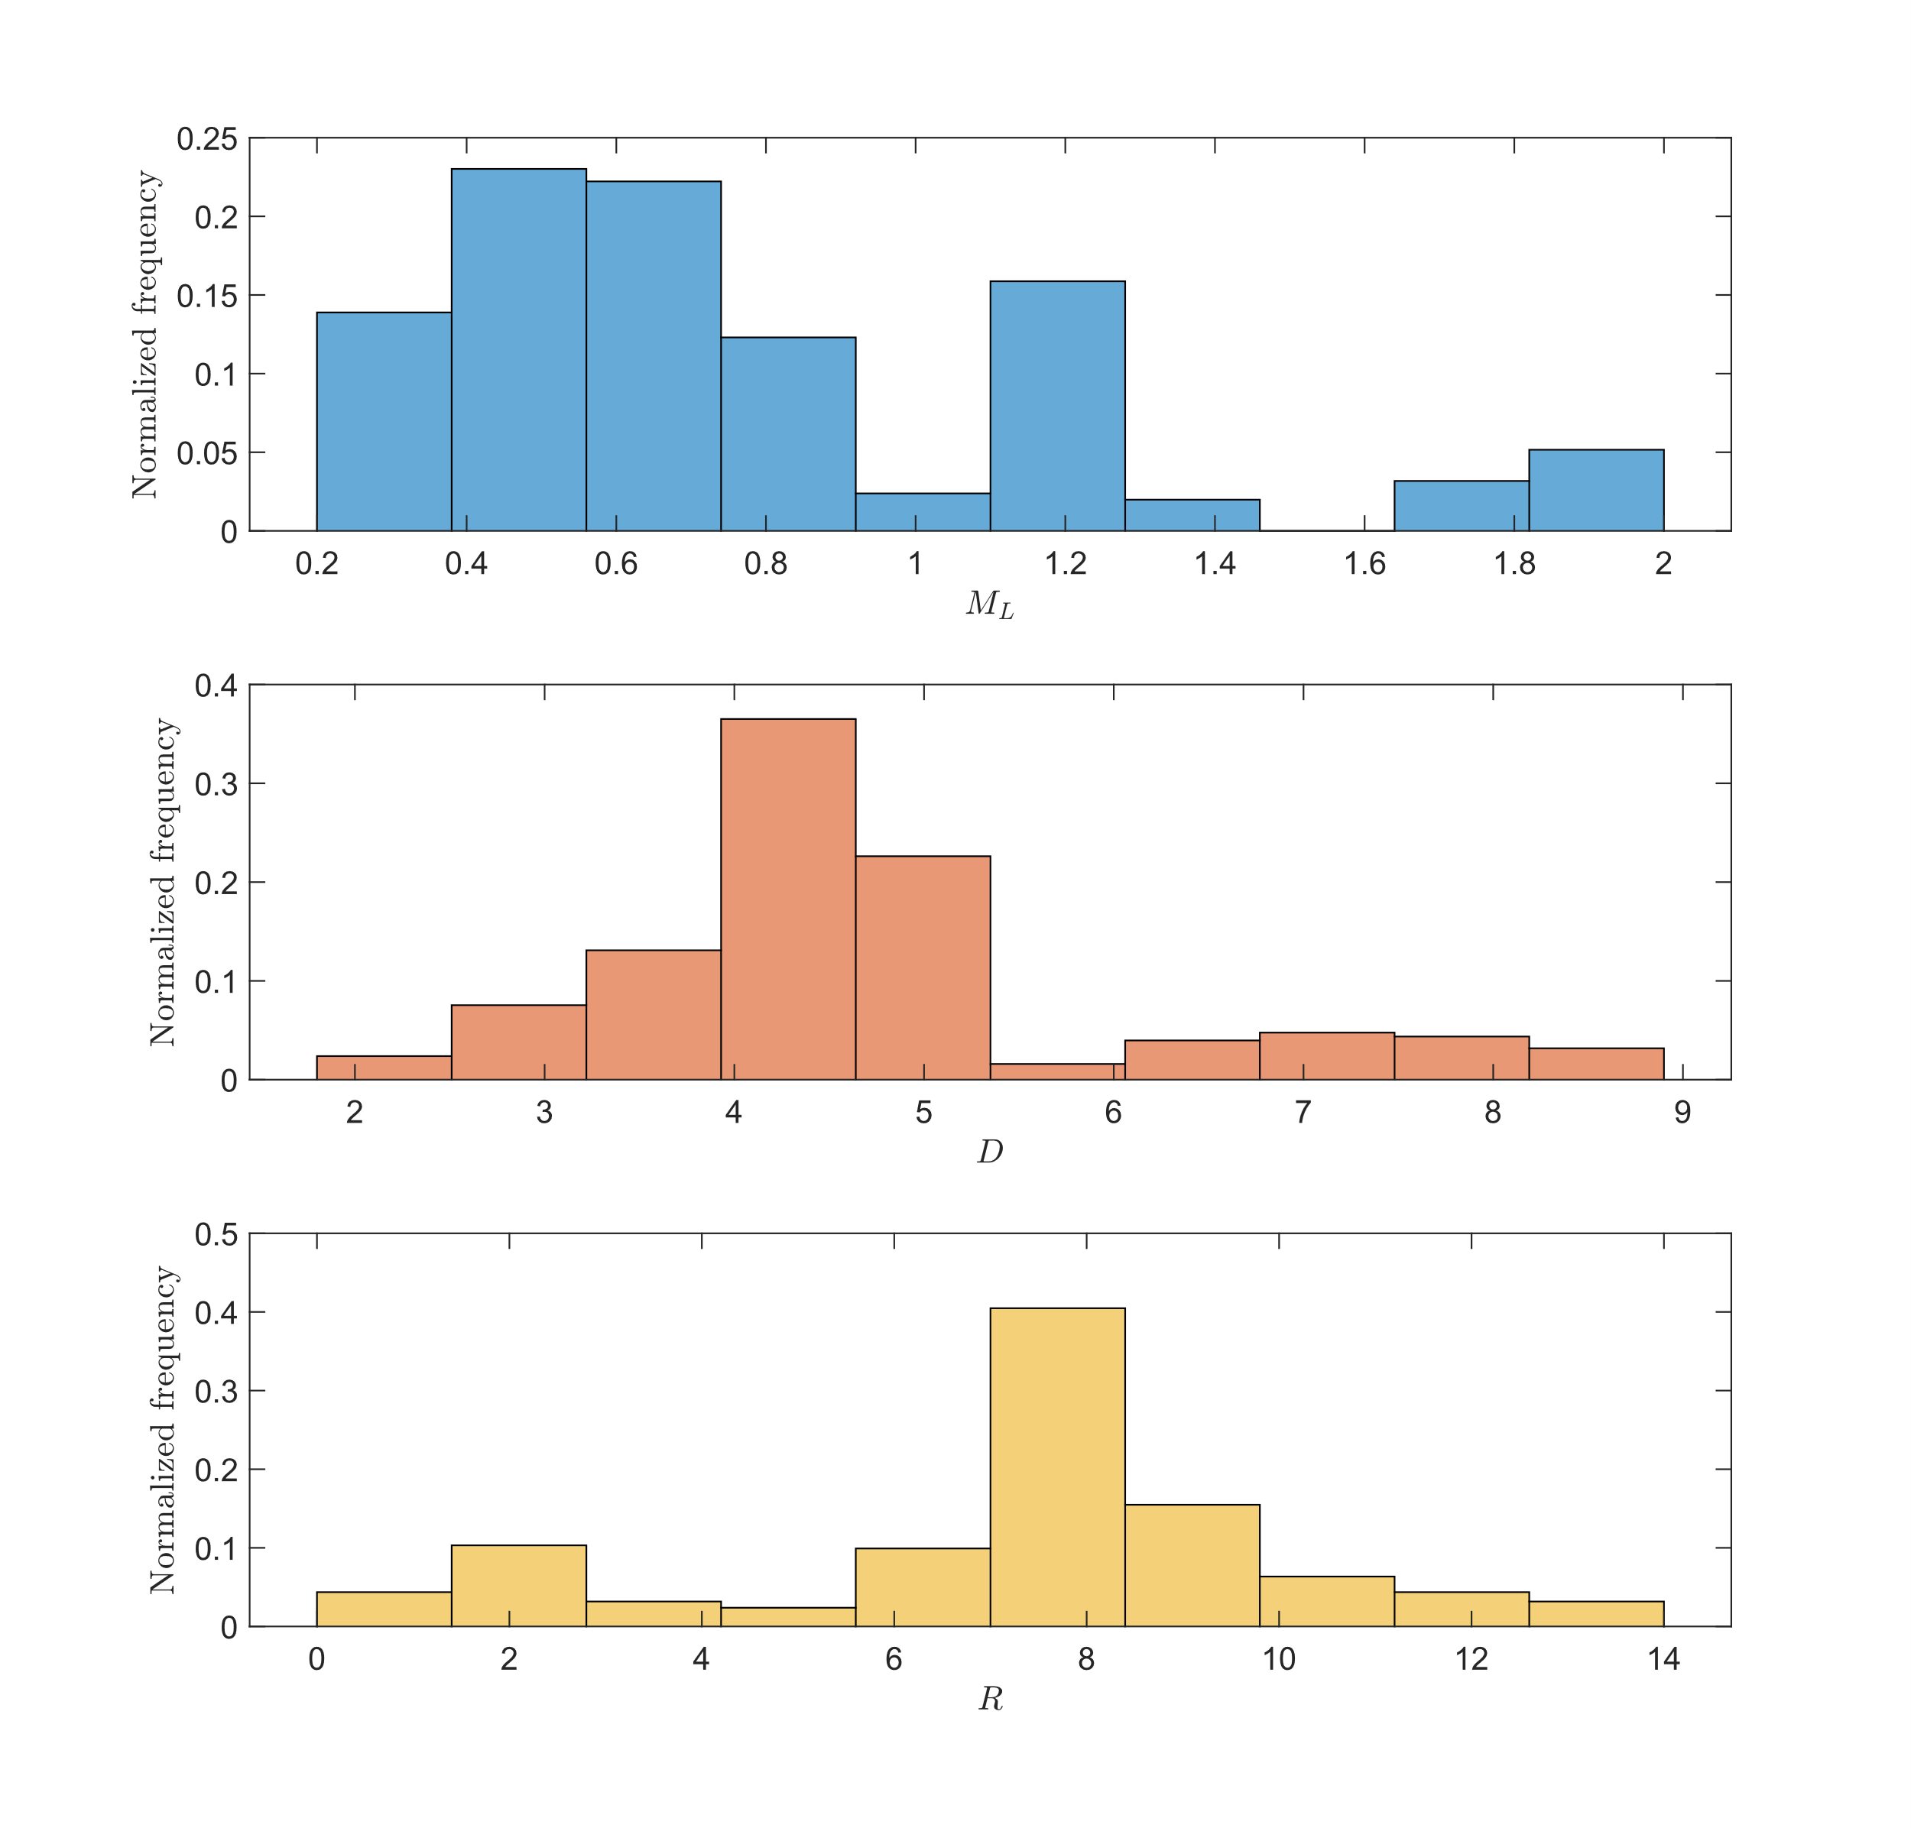
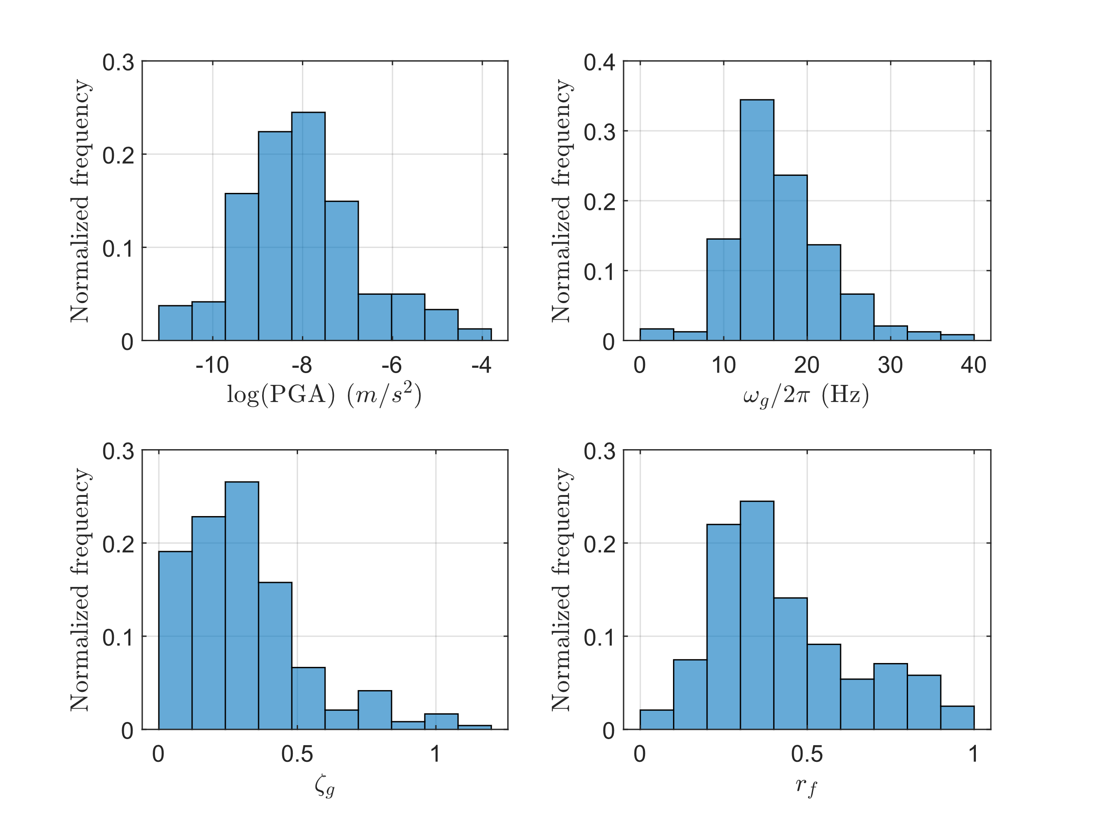
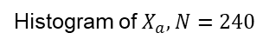
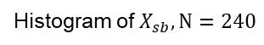
Histogram of parameters
Histogram of $X_{sb}, N=240$
Histogram of $X_{a},N=240$
Notes:
The left side is the histogram of seismic parameter imported from database.
The right side is the modal parameter extracted by fitting with the Hu model.
Since in the seismic parameter, we don’t have any parameter to describe the soil property, therefore here we assume predominated frequency is also one of the seismic parameter. In the next step, we will fit these three modal parameters by those seismic parameters using linear mixed effect model.

Slide 25
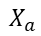
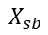
Training LME model
$$X_{sb}$$
LME
$$X_{a}$$
Histogram of $X_{sb}, N=240$
Histogram of $X_{a},N=240$
Notes:
The left side is the histogram of seismic parameter imported from database.
The right side is the modal parameter extracted by fitting with the Hu model.
Since in the seismic parameter, we don’t have any parameter to describe the soil property, therefore here we assume predominated frequency is also one of the seismic parameter. In the next step, we will fit these three modal parameters by those seismic parameters using linear mixed effect model.

Slide 26
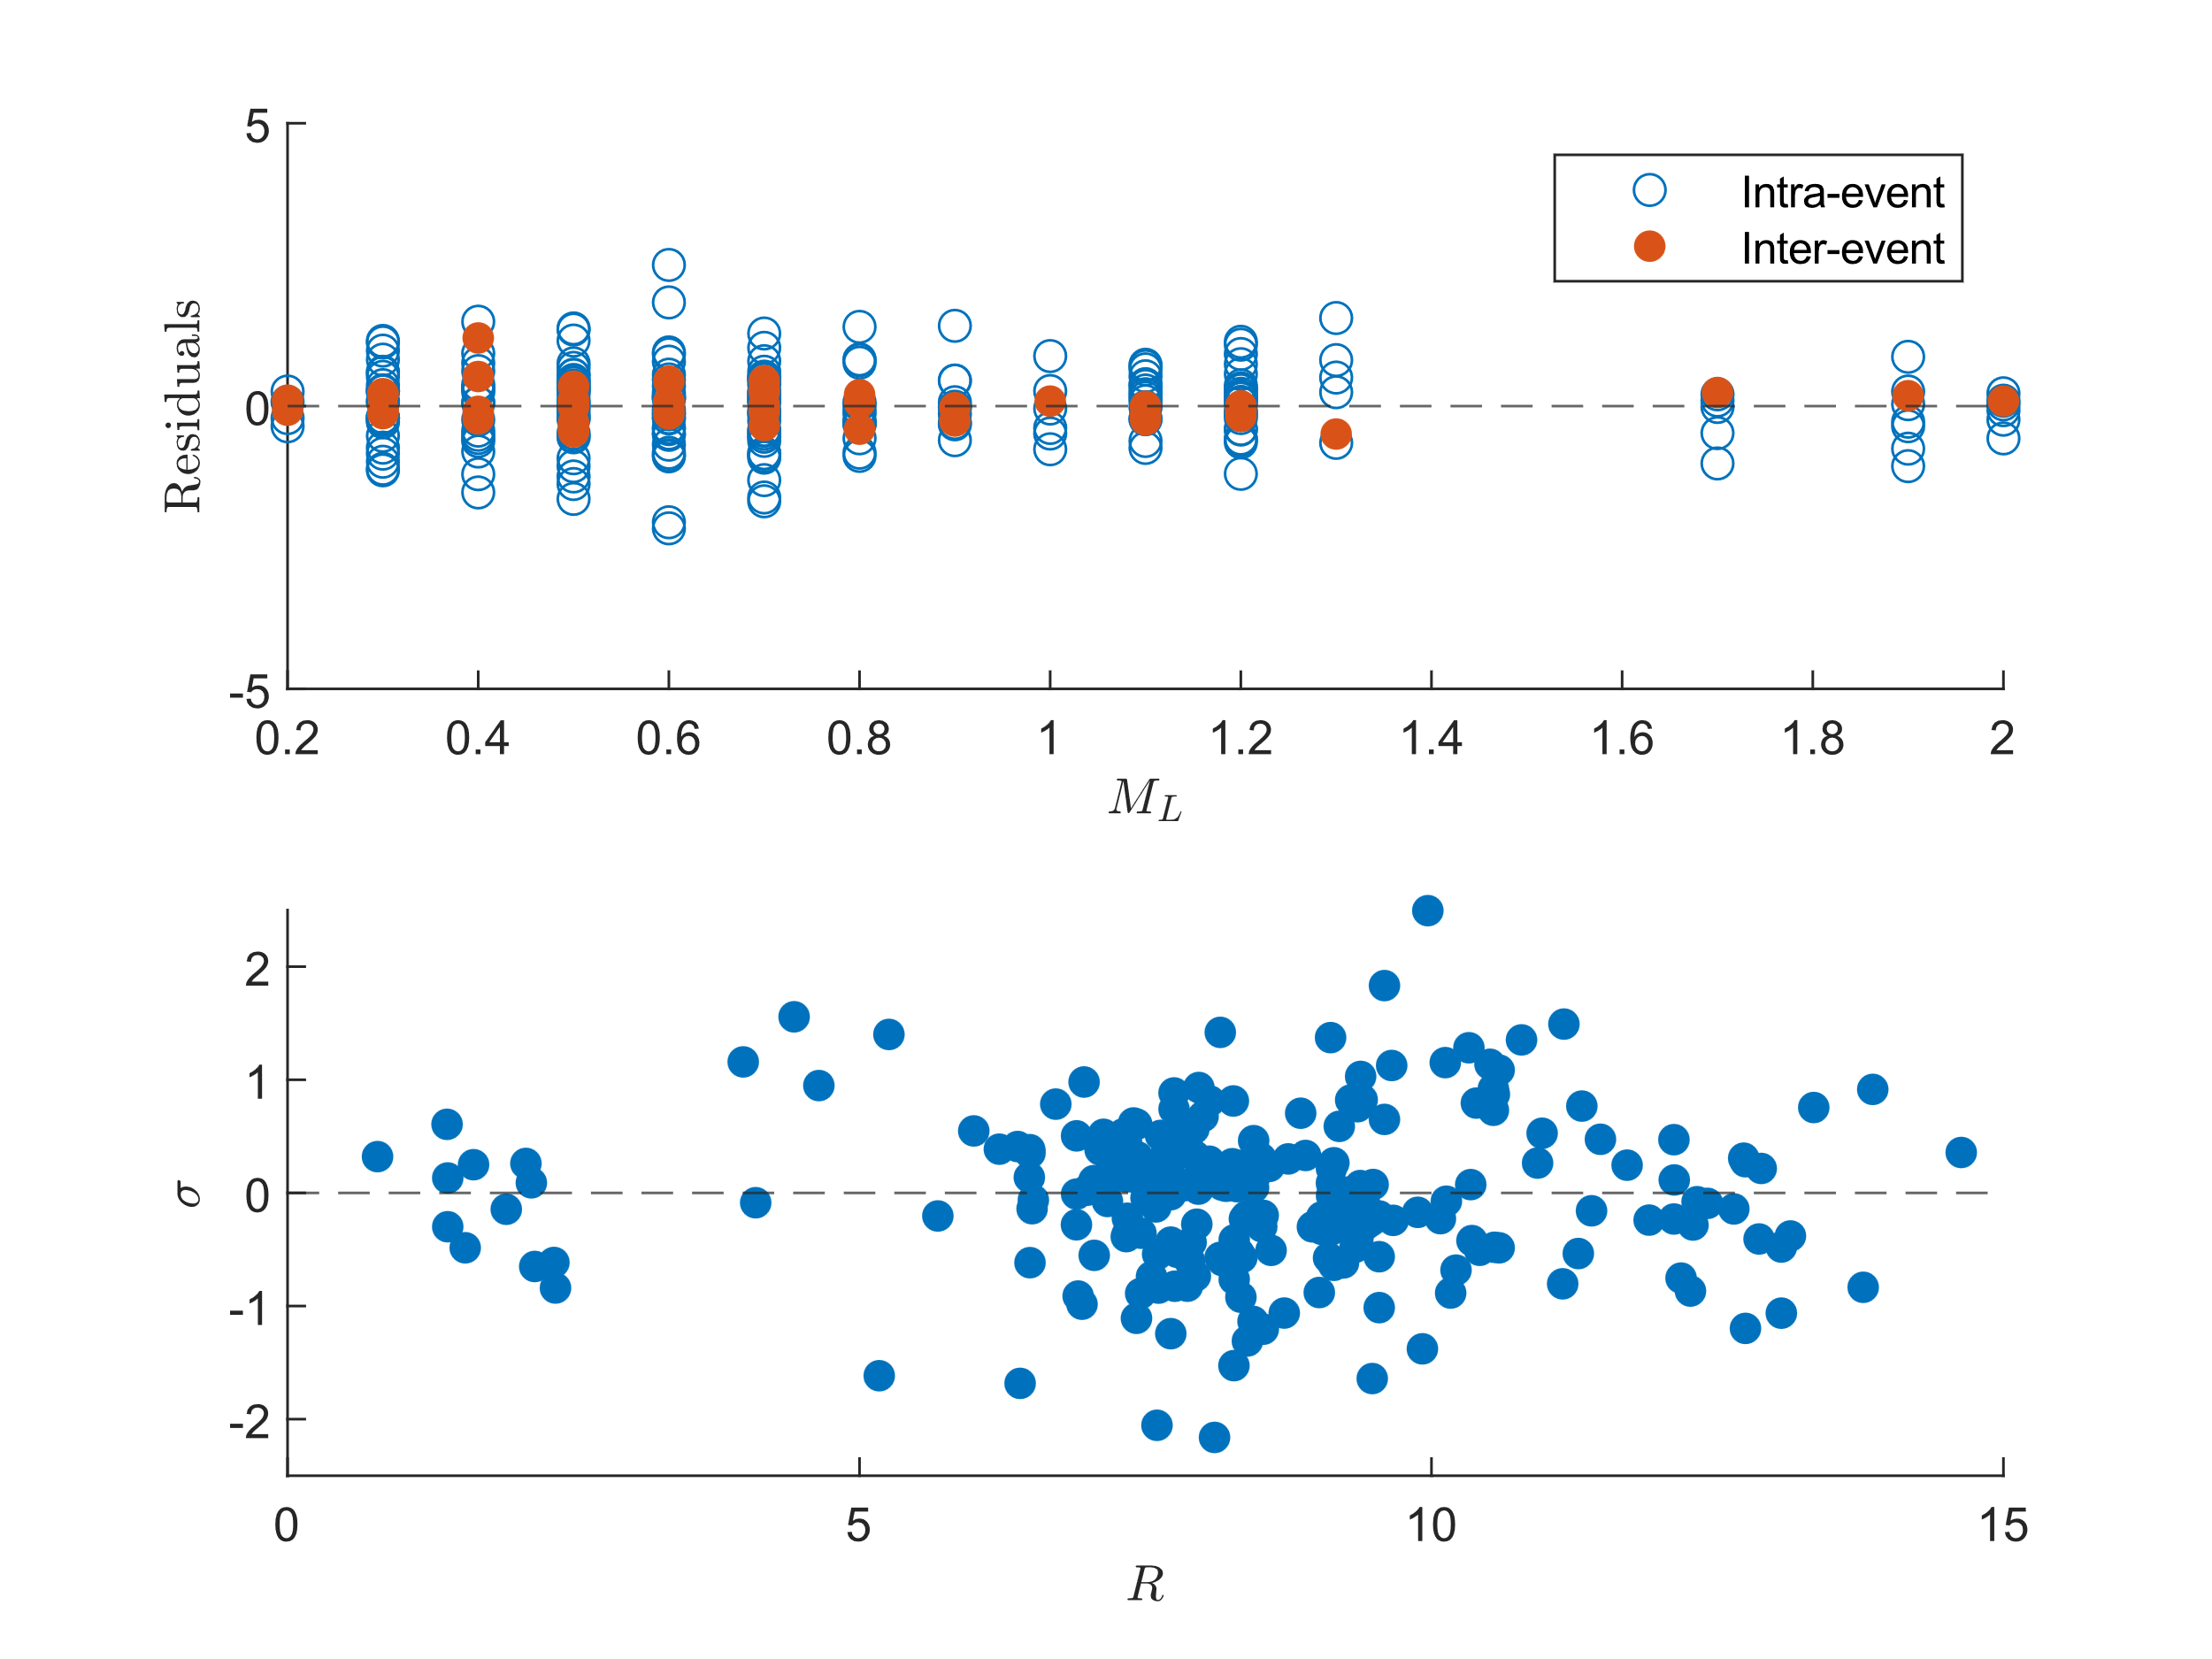
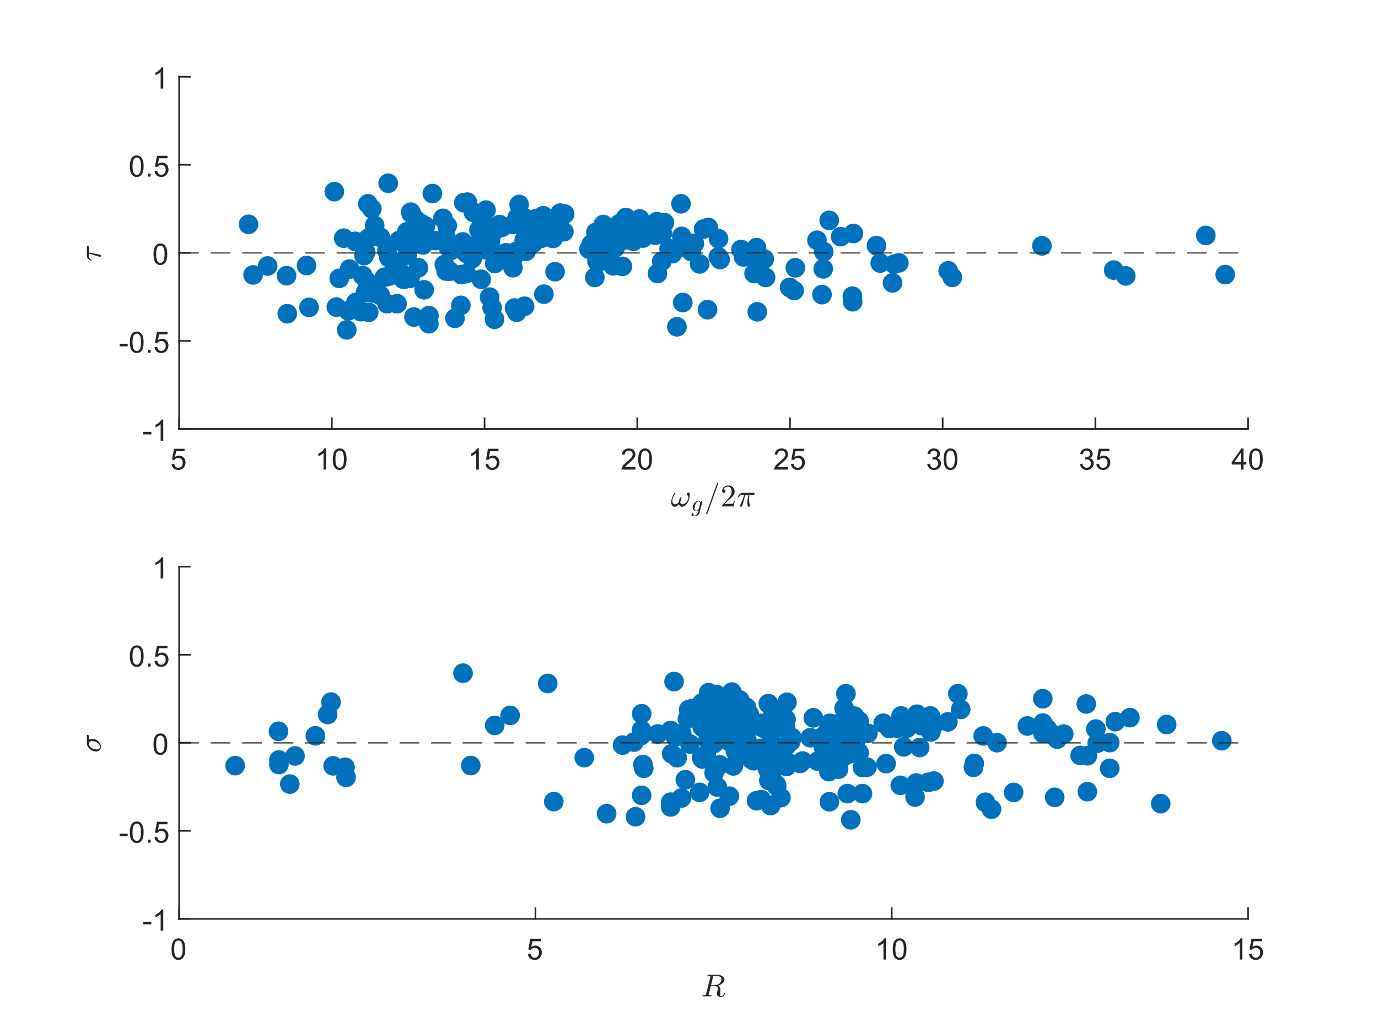
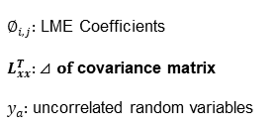
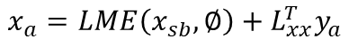
Generate $X_{a}$ by LME and residuals
$∅_{i,j}:$ LME Coefficients
$L_{xx}^{T}:$ $⊿$ of covariance matrix
$y_{a}:$ uncorrelated random variables
$$x_{a}=LME\left(x_{sb},∅\right)+L_{xx}^{T}y_{a}$$
Residuals of fitting ln(PGA) by $M_{L}$ and R in z-direction
Residuals of fitting ${\text{ω}}_{f}$ by ${\text{ω}}_{g}/2π$ and R in z-direction
Notes:
And this is their residuals, which will introduce the stochasticity.

Slide 27
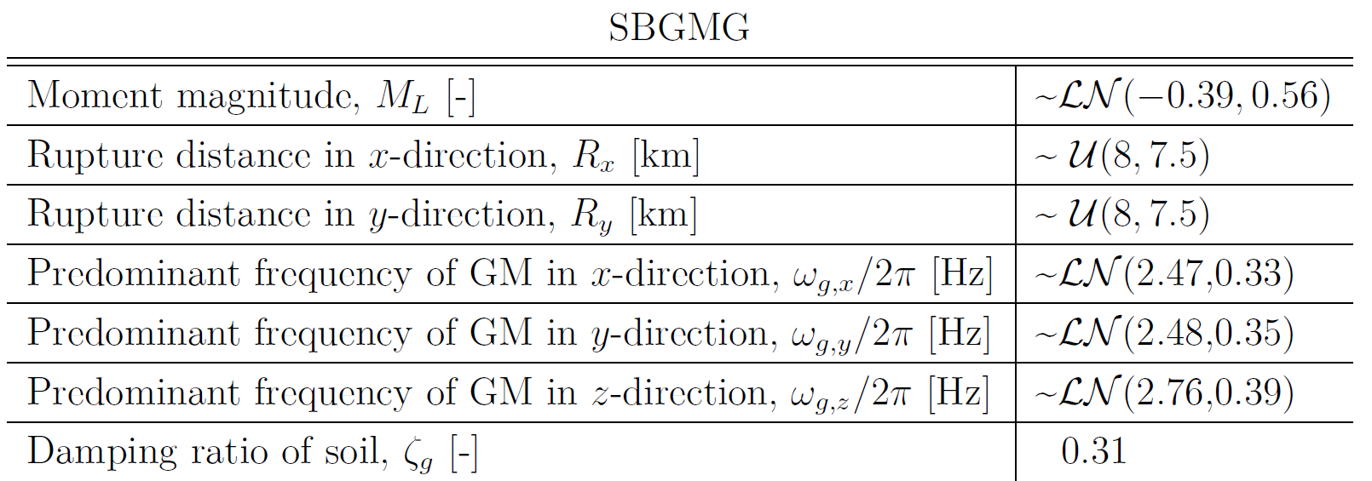
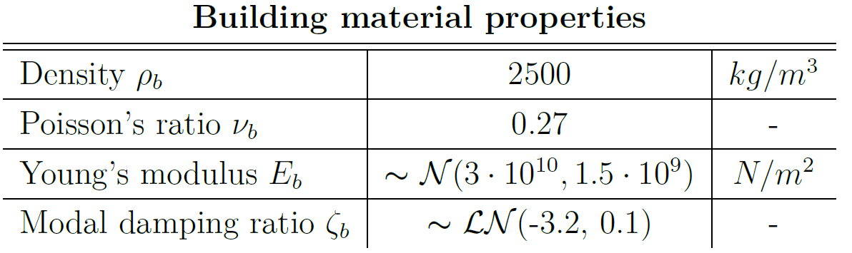
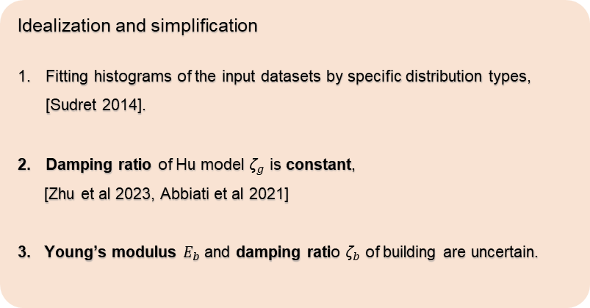
Idealization and simplification
Idealization and simplification
Fitting histograms of the input datasets by specific distribution types, [Sudret 2014].
Damping ratio of Hu model ${\text{ζ}}_{g}$ is constant,
[Zhu et al 2023, Abbiati et al 2021]
3. Young’s modulus $E_{b}$ and damping ratio ${\text{ζ}}_{b}$ of building are uncertain.
Notes:
The right table is the parameter after idealization and use for training SCPE model.
In previous fitting result, we found that damping ratio cannot be fitted by any seismic parameter, so here we assume it as constant. This simplification is also done in other literatures.
For the building material property, we assume Young modulus are followed normal distribution and damping ratio are followed log-normal distribution.
Why damping ratio can be constant?

Slide 28

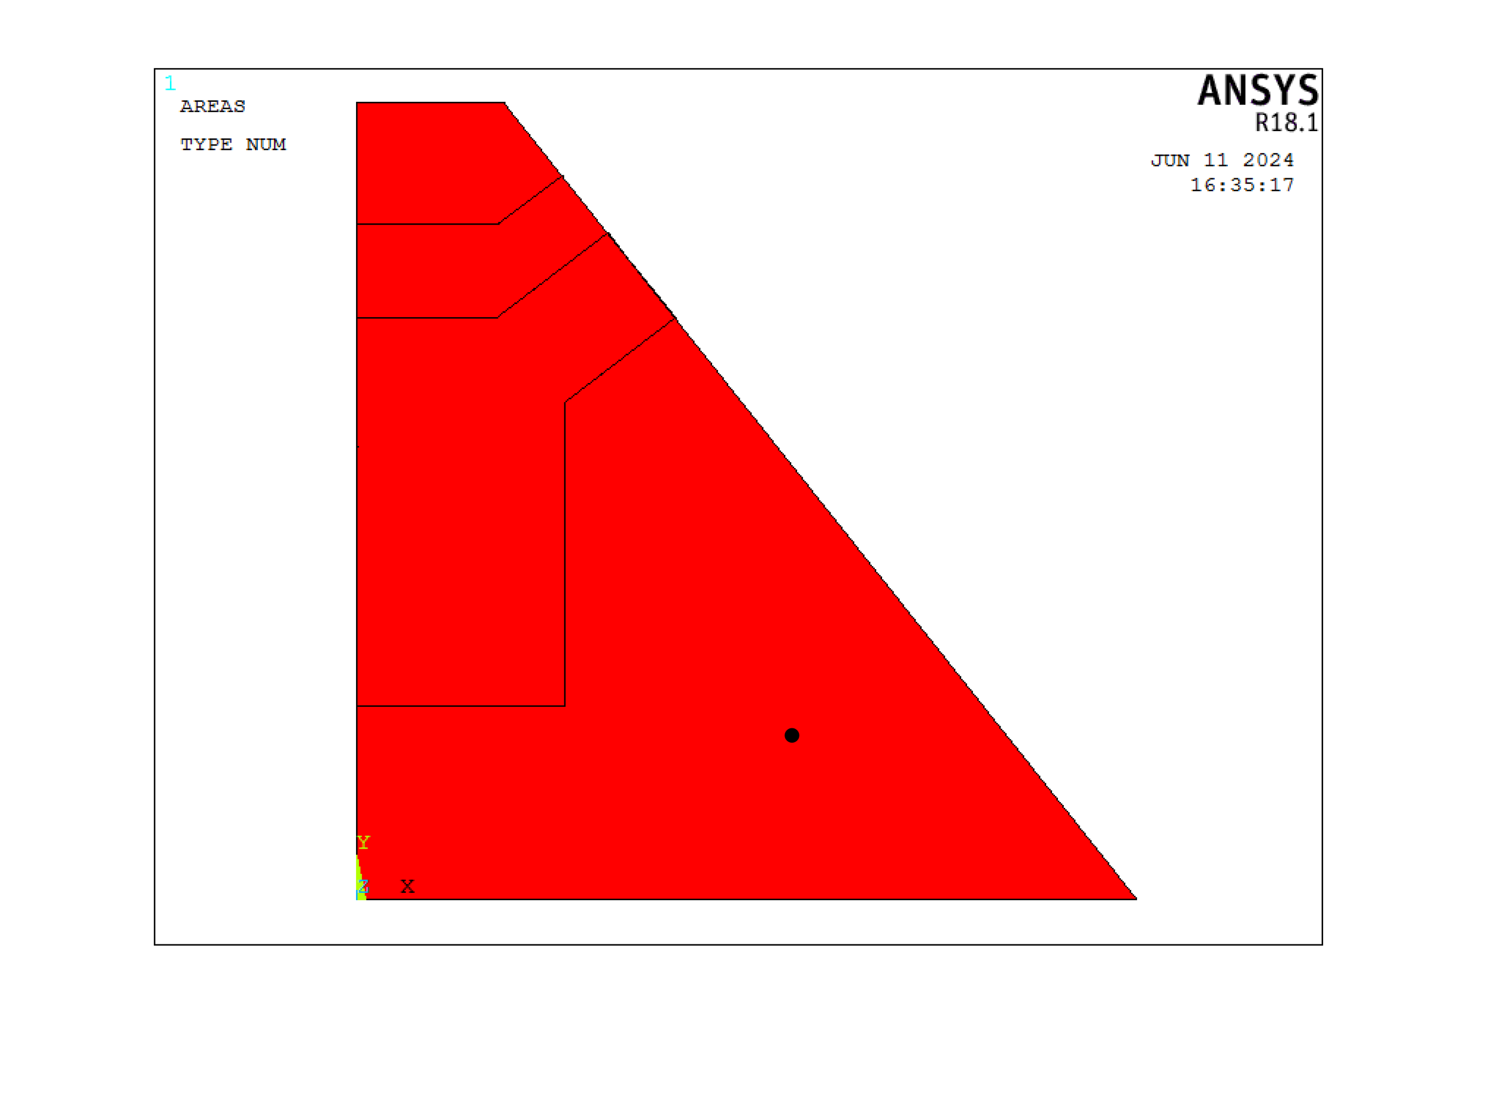
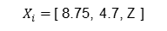
Building example
https://www.tiefegeothermie.de/news/ertuechtigung-der-geothermiebohrungen-taufkirchen
Recorded location:
$X_{i}=$[ 8.75, 4.7, Z ]
Example building in Taufkirchen, Munich
FRF recorded location, [x, y] = [8.75, 4.7] (m)
Notes:
The building examples are the control room of geothermal power plant in Taufkirchen. I record the FRFs of building at this point, which is kind of the center of the slab.

Slide 29
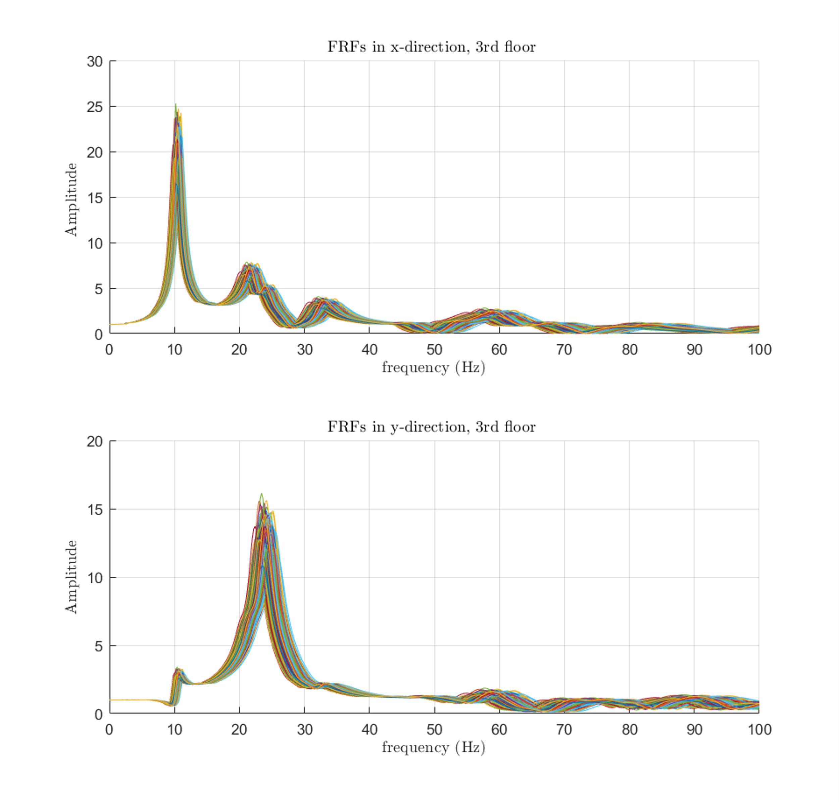

Frequency response functions (N = 500)
Notes:
The left figures are the FRFs in horizontal directions at top floor and the right one is the FRF of vertical direction at each slab.

Slide 30



Simulation
system
FFT
.
IFFT
Notes:
To make simulation more efficient, here we don’t perform the transient analysis directly, instead, we dot product the FRFs of building with artificial ground motions generated by SBGMG in frequency domain then transfer it back to time domain.

Slide 31


Simulation (N = 500)
$$ln⁡(v_{max})$$
system
Notes:
Then we collect the log of all maximum velocity. Here I have 500 simulation results.

Slide 32



SPCE surrogate model: Training
Response surface
Y
SPCE
$$X_{train,i=1,…,500}$$
Validation
$$(LHS sampling)$$
$$Config_file.json$$
Notes:
Once we have all the input datasets and their corresponding maximum velocity, we train the surrogate model and return the response surface and do the validation.

Slide 33


SPCE surrogate model: Results
The response surfaces are plotted for $\ln\left(v_{max}\right)$ against $M_{L}$and R.
Large slope
Slight slope
Response surface in x-direction
Response surface in y-direction
Response surface in z-direction
Notes:
Here we present the response surface against moment magnitude and rupture distance, where the z axis is the log of maximum velocity.
We can find that in all three directions, maximum velocity is positive proportional to M with larger gradient and is negative proportional to R in all directions with smaller gradient.

Slide 34


Global sensitivity analysis:
$M_{L}$ is the most significant parameters in all directions
Overall, $M_{L}$ and R are treated as the top two significant parameters
Notes:
Then here is the Global sensitivity analysis
As you can see, the moment magnitude is always the most significant parameter and the rupture distance should be the second.
In y direction, the predominated frequency is more important than rupture distance, however in my opinion, this is due to the larger gradient of FRF of builing closing the natural frequency.
Overall I will still treat the M and R as top two significant parameter since they influence the amplitude of ground motion directly but the predominated frequency only control the shape of ground motion implicitly.

Slide 35



Serviceability and comfortability assessment
 | Comfortability | Serviceability
Standard code | DIN4150-2 | DIN4150-3
Evaluated value | $${KB}_{Fmax}^{∗}$$ | Maximum velocity
Criteria | Day: $A_{0}=3$ | Horizontal: $15 mm/s$
 | Night: $A_{0}=0.2$ | Vertical: $20 mm/s$
RMS weighted velocity
Fragility surface
${KB}_{Fmax}^{∗}=c_{F}\frac{1}{√2}\frac{v_{max}}{\sqrt{1+{({f_{0}}/f)}^{2}}} , where f_{0}=5.6 Hz,c_{F}$ = 0.8
$$Fragility=P[LS|IM=x_{i}]$$
LS: limit state or damage state
IM: Intensity measurement, i.e. $M_{L},R$
Notes:
Following this, we perform the Serviceability and comfortability assessment and plot the fragility surface based on them.
For the comfortability assessment, we assume this is short term vibration where the building is located in purely residential area.
We compare the root mean square weighted velocity with criteria, A = 3 for day and A = 0.2 for night.
For the serviceability one, we compare the maximum velocity with 15 mm/s in horizontal direction at topmost floor and compare with 20 mm/s in vertical direction for each slab.

Slide 36


Comfotability analysis: DIN4150-2, Day ($A_{0}=3$)
Notes:
This is the fragility plot for day

Slide 37


Comfotability analysis: DIN4150-2, Night ($A_{0}=0.2$)
Notes:
This is for night, as you can see, since the criteria value is low for night, it is very easy to make resident uncomfortable at night.

Slide 38



Comfotability analysis: DIN4150-2, Night ($A_{0}=0.2$)
$M_{L}≤$1.2
R$≥6 km$
Notes:
However, if we compare to the histogram of database, we can found that most of the m are lower than 1.2 and most of the R are higher than 6, which is this area.
Therefore even the fragility curve shows that it is easy to exceed the criteria, but it might not be that severe in this case.

Slide 39


Serivicability analysis: DIN4150-3 ${(v}_{x},v_{y}=15, v_{z}=20 [\frac{mm}{s}])$
Notes:
And this is the serviceability analysis, basically, there is only few damage might happen in this case study.

Slide 40
Conclusion and outlook

Slide 41

Conclusion and outlook
Conclusion
Geothermally induced earthquake might affect comfortability especially at night in residential area.
Geothermally induced earthquake has less impact on serviceability.
$M_{L}$ and $R$should be the top two most significant seismic parameters.
Outlook
A better, full-scaled assessment should include non-linear analysis.
Evaluate the vibration of the whole structure instead of FRF of one recorded point.
The computational cost of training the SPCE model is still too high.
Notes:
In conclusion, the geothermal induced ground motion might slightly affect the comfortability, especially at night in the purely residential area, and it only has less impact on serviceability.
According to global sensitivity analysis, moment magnitude and rupture distance could be the top two important parameters.
Currently, my thesis only focus on the serviceability and comfortability assessment, however ,if we want a full scaled analysis, we also have to consider other analysis, such as pushover analysis. And we should evaluate the vibration of the whole structure instead of focusing on the FRF of some specific point.

Slide 42
Reference
[Küperkoch et al 2018] Küperkoch, L ; Olbert, K ; Meier, T: Long-term monitoring of induced seismicity at the Insheim geothermal site, Germany. In: Bulletin of the Seismological Society of America 108 (2018), Nr. 6, p. 3668–3683
[Pan et al 2016] Pan, Chao ; Zhang, Ruifu ; Luo, Hao ; Shen, Hua: Baseline correction of vibration acceleration signals with inconsistent initial velocity and displacement. In Advances in Mechanical Engineering 8 (2016), Nr. 10, p. 1687814016675534
[Abbiati et al 2021] Abbiati, Giuseppe ; Broccardo, Marco ; Abdallah, Imad ;Marelli, Stefano ; Paolacci, Fabrizio: Seismic fragility analysis based on artificial ground motions and surrogate modeling of validated structural simulators. In: Earthquake Engineering & Structural Dynamics 50 (2021), Nr. 9, p. 2314–2333
[Khansefid et al 2021] Khansefid, Ali ; Yadollahi, Mahmoudreza ; Müller, Gerhard ; Taddei, Francesca: Seismic Risk Assessment of a Masonry Building Due to the Geothermal Power Plant Earthquakes. Lehrstuhl für Baumechanik, 2021
[Chen et al 2022] Chen, Bo ; Sun, Guangjun ; Li, Hongjing: Power spectral models of stationary earthquake-induced ground motion process considering site characteristics. In Emergency Management Science and Technology 2 (2022), Nr. 1, p. 1–12
[Sudret 2014] Sudret, Bruno: Polynomial chaos expansions and stochastic finite element methods. In Risk and reliability in geotechnical engineering (2014), p. 265–300
[Zhu and Sudret 2023] Zhu, Xujia ; Sudret, Bruno: Stochastic polynomial chaos expansions to emulate stochastic simulators. In: International Journal for Uncertainty Quantification 13 (2023), Nr. 2
[Zhu et al 2023] Zhu, Xujia ; Broccardo, Marco ; Sudret, Bruno: Seismic fragility analysis using stochastic polynomial chaos expansions. In: Probabilistic Engineering Mechanics 72 (2023), p. 103413
[Rezaeian 2010] Rezaeian, Sanaz: Stochastic modeling and simulation of ground motions for performance-based earthquake engineering. University of California, Berkeley, 2010

Slide 43
Thank you for your attention!

Slide 44






AGMG Model
Hu model - $M_{hu}$($Ω,ω_{g},ζ_{g},r_{h}$)
Spectral stationary
Excited by Gaussian color noise
The soil layer is a linear SDOF system
Modify from Kanai-Tajimi (K-T) model: Making model more realistic in low- frequency range.
FRF of Hu model
GWN
Time modulating function - $\hat{q}(t, t_{d},r_{mid})$
Temporal non-stationary
Gamma PDF-shape like
Amplitude is controlled by peak ground acceleration (PGA)
$$M_{hu}(Ω,ω_{g},ζ_{g},r_{h})=\frac{−iΩ^{3}}{−iΩ^{3}+{r_{h}}^{3}{ω_{g}}^{3}}\frac{−i2Ωζ_{g}ω_{g}−{ω_{g}}^{2}}{\left(Ω^{2}−{ω_{g}}^{2}\right)−i2Ωζ_{g}ω_{g}}\ddot{U}(Ω)$$
IFFT
${GM}_{vel}=PGA\frac{\hat{q}(t, t_{d},r_{mid}) }{max⁡(|\hat{q}(t, t_{d},r_{mid})M_{hu}(t,X_{hu})|)}$ $M_{hu}(t,X_{hu})$
Time modulating function
$$X_{a}=\left\{ X_{hu} ;X_{tmf}\right\}$$
,where $X_{hu}=\left\{ ω_{g},{\text{ζ}}_{g},r_{h}\right\}$, $X_{tmf}=\{ PGV, t_{d},r_{mid}\}$
Notes:
In AGMG, there are two parts, which are Hu model and Time modulating function.
In Hu model, we assume the soil layer is the SDOF system, which is controlled by predominated frequency, omega and damping ratio, zeta.
The rock acceleration is Gaussian white noise filtering by the high-pass filter, where the cutoff frequency is controlled by rh.
For time modulating function, it is a gamma-probability-density-function-shape-like curve which is controlled by the duration and the time where the largest amplitude occurs.
When we build the Frequency response function of Hu model, we dot product it with Gaussian white noise in frequency domain then transfer it back to time domain by IFFT. After this, we dot product it with time modulating function again then normalized it.
In the end, we control the amplitude of this ground motion by peak ground acceleration.

Slide 45

Step 1: Extract model parameters $X_{a}$
Fitting procedure
Fitting the Hu model in frequency domain
Using nonlinear least square method [Chen et al 2022]
Extract the model parameters $X_{a}$ from each records
In the database, we have over 200 records from approximate 50 events
Notes:
Here is the flow chart of it.
The modal parameters for building AGMG can be first extracted by nonlinear least square method. And we build the frequency response function based on recorded ground motion.

Slide 46


Step 2: Generate Gaussian white noise (GWN)
FFT
Notes:
Then we generate Gaussian white noise and transfer to frequency domain.

Slide 47


Step 3: Excite Hu model by GWN
$$∙ =$$
Notes:
Dot product the gaussian white noise with FRF

Slide 48

Step 3-1: Excite Hu model by GWN
IFFT
Notes:
Then transfer it back to time domain.
As you can see, it is still look like white noise since we only change its characteristic in frequency domain but not in time domain.

Slide 49

Step 4: Dot product with time modulating function
Notes:
Then we dot product it with time modulating function, making it time-nonstationary.

Slide 50


Linear mixed effect model (LME)
Why we need LME model ?
Each event includes several recorded GMs.
Describe the relationship between seismic parameters $X_{sb}$ and model parameters $X_{a}$
Introduce stochasticity by intra and inter-event residuals.
[Küperkoch et al 2018]
Station | TMO55 | TMO22 | TMO20 | INS8 | INS1
Time | 2023.01.11-13:55:29
$$M_{L}$$ | 0.7
D (km) | 5
R (km) | 7.3035 | 5.1721 | 8.2915 | 10.3534 | 9.3079
Inter-event: within a single event or group
Intra-event: between different events or groups
Notes:
For example, this event occur on January 11th in 2023 is recorded by 5 stations with different rupture distances but only one moment magnitude and depth.
This kind of data structure make simple linear regression not appropriate.
Therefore, we use the linear mixed effect model , since it can deal with this kind of data structure by fitting the intra and inter event error.
This is also the part where the stochasticity generated mainly.

Slide 51



LME fitting results – first trail (modified from [Rezaeian 2010])
$\ln\left(PGA\right)= ∅_{1,0}+∅_{1,1}∙M_{L}+∅_{1,2}∙\ln\left(D\right)+∅_{1,3}∙\ln\left(R\right)+∅_{1,4}∙ω_{g}+{\hat{\text{η}}}_{1}+{\hat{ε}}_{1}$
$r_{h}=∅_{2,0}+∅_{2,1}∙M_{L}+∅_{2,2}∙D+∅_{2,3}∙R+∅_{2,4}∙ω_{g}+{\hat{\text{η}}}_{2}+{\hat{ε}}_{2}$
${\text{ζ}}_{g}=∅_{3,0}+∅_{3,1}∙M_{L}+∅_{3,2}∙D+∅_{3,3}∙R+∅_{3,4}∙ω_{g}+{\hat{\text{η}}}_{3}+{\hat{ε}}_{3}$
$∅_{i,j}:$ LME Coefficients
${\hat{\text{η}}}_{i} :$ Inter-event residuals
${\hat{ε}}_{i }:$Intra-event residuals
Notes:
In the first trail, we try to fit the log of PGA, cutoff frequency and damping ratio by moment magnitude, depth, rupture distance and predominated frequency.
Here, each “i” indicate index of LME coefficients, where the estimates are their corresponding value and P-value are shown in the last column.
You can see that for second rows, it shows that the significant of depth is small due to high p-value when fitting each modal parameter, therefore I will remove it in next trail. Also moment magnitude seems to have less relationship with r and zeta, so it will also be removed when fitting this two parameter in next trail.

Slide 52


LME fitting results – second trail
$\ln\left(PGA\right)= ∅_{1,0}+∅_{1,1}∙M_{L}+∅_{1,2}∙\ln\left(R\right)+{\hat{\text{η}}}_{1}+{\hat{ε}}_{1}$
$r_{h}=∅_{2,0}+∅_{2,1}∙R+∅_{2,2}∙ω_{g}+{\hat{ε}}_{2}$
${\text{ζ}}_{g}=∅_{3,0}+∅_{3,1}∙R+∅_{3,2}∙ω_{g}+{\hat{ε}}_{3}$
$∅_{i,j}:$ LME Coefficients
${\hat{\text{η}}}_{i} :$ Inter-event residuals
${\hat{ε}}_{i }:$Intra-event residuals
Notes:
In the second trail, we modify the fitting function like this.
As you can see, PGA and r can be fitted well, but zeta still cannot be fitted by any parameter.

Slide 53



LME fitting results
$\ln\left(PGA\right)= ∅_{1,0}+∅_{1,1}∙M_{L}+∅_{1,2}∙\ln\left(R\right)+{\hat{\text{η}}}_{1}+{\hat{ε}}_{1}$
$r_{h}=∅_{2,0}+∅_{2,1}∙R+∅_{2,2}∙ω_{g}+{\hat{ε}}_{2}$
${\text{ζ}}_{g}=∅_{3,0}+∅_{3,1}∙R+∅_{3,2}∙ω_{g}+{\hat{ε}}_{3}$
ln(PGA) is fitted by the parameters: $M_{L}$ and R .
Frequency of high-pass filter for Hu model (${\text{ω}}_{f}$) is fitted by the parameters: ${\text{ω}}_{g}/2π$ and R.
Damping ratio of Hu model (${\text{ζ}}_{g}$) cannot be fitted well by any proposed seismic parameter $X_{sb}$
According to LME coefficients, ln(PGA) is positive proportional to $M_{L}$ but is negative proportional to R.
$∅_{i,j}:$ LME Coefficients
${\hat{\text{η}}}_{i} :$ Inter-event residuals
${\hat{ε}}_{i }:$Intra-event residuals
Notes:
Here is the short summary, basically, damping ratio cannot be fitted well by any proposed seismic parameters and PGA is positive proportional to $M_{L}$ but is negative proportional to R.

Slide 54

Idealization and simplification
Idealization and simplification
Since SCPE is parametric surrogate model, the input datasets have to follow Normal distribution, Uniform distribution or any probability distribution mentioned in [Sudret 2014] .
Idealized Moment magnitude $M_{L}$ by log-normal distribution.
Idealized Rupture distance $R_{x}$ and $R_{y}$by uniform distribution.
Idealized predominate natural frequency ${\text{ω}}_{g}/2π$ by log-normal distribution.
Damping ratio of Hu model ${\text{ζ}}_{g}$ is simplified as constant [Zhu et al 2023, Abbiati et al 2021].
For the building parameters, Young’s modulus $E_{b}$ and damping ratio ${\text{ζ}}_{b}$ are idealized by normal and log-normal distribution, respectively.
Notes:
The right table is the parameter after idealization and use for training SCPE model.
In previous fitting result, we found that damping ratio cannot be fitted by any seismic parameter, so here we assume it as constant. This simplification is also done in other literatures.
For the building material property, we assume Young modulus are followed normal distribution and damping ratio are followed log-normal distribution.
Why damping ratio can be constant?

Slide 55


SPCE
Can capture not only the uncertainty form seismic parameter $X_{sb}$, but also the unknown stochasticity in stochastic simulator (SMGMG) by latent variable $Z$.
The mean function, formed by PCE, is fitted by regression technique. Its coefficient sets is fitted by L-BFGS-B.
The residuals (error) of mean function is fitted by normal distribution with standard deviation $σ$ by maximum likelihood estimation using GP
Easy to apply global sensitivity analysis (GSA).
Notes:
As mentioned previously, SPCE is parametric based, which mean the input parameter have to follow required distribution such as normal or uniform distribution or so on.
To capture the stochasticity in the system, we can first list several possible distribution type. After running the algorithm, SPCE will return the most possible distribution type of stochasticity in the system by minimizing the cross-validation score.
To train the model, we also have to consider the residuals of fitting. Here we assume it is always followed the normal distribution with zero mean. Its variance will be fitted by Gaussian process optimization.
The mean function of SPCE is the PCE surrogate model. Its fitted coefficient will be found by L-BFGS-B optimization technique.

Slide 56

Global sensitivity analysis:
$M_{L}$ is the most significant parameters in all directions
In SBGMG, R equals to $\sqrt{R_{x}^{2}+ R_{y}^{2}}$, both of $R_{x}$and $R_{y}$ are followed uniform distribution, therefore they show the similar significant.
In y direction, $ω_{g}/2π$ is second significant parameter, this might be due to the large gradient of FRF closed to building’s natural frequency.
Overall, I still treat $M_{L}$ and R as the top two significant parameters since they affect the PGA of ground motion explicitly.
Notes:
Then here is the Global sensitivity analysis
As you can see, the moment magnitude is always the most significant parameter and the rupture distance should be the second.
In y direction, the predominated frequency is more important than rupture distance, however in my opinion, this is due to the larger gradient of FRF of builing closing the natural frequency.
Overall I will still treat the M and R as top two significant parameter since they influence the amplitude of ground motion directly but the predominated frequency only control the shape of ground motion implicitly.

Slide 57

SPCE surrogate model: Validation
Global validation
Local validation
Notes:
When perform validation, as you can see, the histogram in blue are the validation set, which are the different sets for training one. The red PDF curve is the prediction of the SPCE. We did the validation globally and locally. In the local validation, it is used to test whether the model can capture the stochasticity from the system itself. As you can see, they align quite well.

Slide 58

SPCE convergence and training time
Satisfactory accuracy is assumed to be reached when $E{[ε}_{val}] ≤0.05, where ε_{val}=\frac{E[d_{ws}^{2}(Y_{x},{\hat{Y}}_{X})]}{Var[Y]}$
To speed up the training, the self-written SPCE using parallel programming technique for GP. (6 cores).
If $p, q_{norm }=\left[4, 1\right]$ and N = 400, using 6 cores can reduce the training time from appr. 6.8 hrs. to 1.8 hrs.
Computer specification
CPU | AMD Ryzen 9 3900XT 12-Core Processor
CPU speed | 3.80 GHz
RAM | 32.0 GB
$$ε_{val}=0.05$$
Error convergence
Training time comparison
Notes:
In my thesis, we compute the error using mean of Wasserstein distance of order of two then normalized it with variance. The Wasserstein distance describes the distance between two probability distribution. Here we assume that the satisfactory accuracy is reached when error is smaller than 0.05.
In my self-written SPCE, I also used the parallel programming technique for Gaussian process.
Here I trained the model using 6 cores under this computer spec, it can speed up the training process from 6,8 hours to 1.8 hours, which is more than 3 times faster.

Slide 59




Serviceability and comfortability assessment
Comfortability assessment
Evaluated according to DIN4150-2
Assumed infrequent, short-term vibration.
Buildings in areas which are predominantly or purely residential
Empirical values for constant $c_{F}$ is 0.8.
Criteria: $A_{0}=3$ for day and $A_{0}=0.2$ for night
Using r.m.s weighted velocity ${KB}_{Fmax}^{∗}$ to evaluate.
Serviceability assessment
Evaluated according to DIN4150-3
Assumed Residential buildings
Evaluate topmost floor for horizontal directions, where guideline value for $v_{x},v_{y}=15 mm/s$ for all frequencies.
Evaluate each floor slab for vertical directions, where guideline value for $v_{z}=20 mm/s$ for all frequencies.
Fragility surface
$${KB}_{Fmax}^{∗}=c_{F}\frac{1}{√2}\frac{v_{max}}{\sqrt{1+{({f_{0}}/f)}^{2}}} , where f_{0}=5.6 Hz$$
$$Fragility=P[LS|IM=x_{i}]$$
LS: limit state or damage state
IM: Intensity measurement, i.e. $M_{L}$
Notes:
Following this, we perform the Serviceability and comfortability assessment and plot the fragility surface based on them.
For the comfortability assessment, we assume this is short term vibration where the building is located in purely residential area.
We compare the root mean square weighted velocity with criteria, A = 3 for day and A = 0.2 for night.
For the serviceability one, we compare the maximum velocity with 15 mm/s in horizontal direction at topmost floor and compare with 20 mm/s in vertical direction for each slab.

Slide 60

SPCE surrogate model: Results
The response surfaces are plotted for $\ln\left(v_{max}\right)$ against $M_{L}$and R.
$\ln\left(v_{max}\right)$is positive proportional to $M_{L}$ in all directions with larger gradient.
$\ln\left(v_{max}\right)$ is negative proportional to R in all directions with smaller gradient.
Large slope
Slight slope
Response surface in x-direction
Response surface in y-direction
Response surface in z-direction
Notes:
Here we present the response surface against moment magnitude and rupture distance, where the z axis is the log of maximum velocity.
We can find that in all three directions, maximum velocity is positive proportional to M with larger gradient and is negative proportional to R in all directions with smaller gradient.

Slide 61


Idealization and simplification of $X_{sb}$
Notes:
After this, I idealize the simplify the input parameter to reduce the problem.
What’s more, idealization is necessary since the SPCE is not non-parametric, so we have to let the input seismic parameter follow some certain distribution.

Slide 62

Conclusion and outlook
Conclusion
The SBGMB can generate artificial ground motion with characteristics and patterns similar to recorded data, even when accounting for stochasticity.
The accuracy of the SPCE model is positively proportional to $p,q$ and $N$. For current problem, $p≥3,q≥0.75,N≥400$ can reach satisfactory accuracy.
The computational time for training the SPCE model is negatively proportional to $p,q$ and $N$. Using parallel programming technique with 6 cores can accelerate appr. 3.3 times than using single core.
$M_{L}$ and $R$should be the top two most significant seismic parameters influencing the response.
The result shows that geothermally induced earthquake might affect comfortability especially at night in purely residential area.
The result shows that geothermally induced earthquake has less impact on serviceability.
Outlook
The SBGMG can be improved by introducing spectral non-stationary ground motion model.
Introducing non-parametric probability based surrogate model [Zhong et al 2023]. With this approach, less simplification has to be done, and a more complex relationship in the system can be presented.
A better, full-scaled assessment should include non-linear analysis, e.g., pushover analysis.
It is recommended to evaluate the vibration of the whole structure instead of using FRF of one recorded point.
The computational cost of training the SPCE model is still too high, although parallel programming technique and faster optimization algorithm, L-BFGS-B, are used in self-written SPCE.
Notes:
In conclusion, the geothermal induced ground motion might slightly affect the comfortability, especially at night in the purely residential area, and it only has less impact on serviceability.
According to global sensitivity analysis, moment magnitude and rupture distance could be the top two important parameters.
Currently, my thesis only focus on the serviceability and comfortability assessment, however ,if we want a full scaled analysis, we also have to consider other analysis, such as pushover analysis. And we should evaluate the vibration of the whole structure instead of focusing on the FRF of some specific point.

